Slide 1


Back to Life
Session 2:
Combining Physical and Psychological Treatment for back pain

Slide 2
Review of last week
Understanding pain
Myths and misconceptions
Relaxation practice
Notes:
Check learning points have been achieved from last session
Offer opportunity for further questions

Slide 3
Introducing today’s session
How managing activity levels can help you recover
Understanding avoidance and overdoing it
What does exercise and relaxation do to the body?
Setting goals for recovery
Notes:
Set the scene for the day

Slide 4
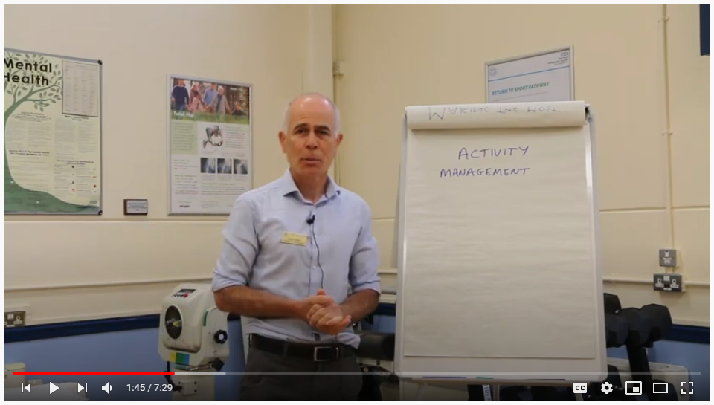
Activity management
https://youtu.be/m40sbip1dBc

Slide 5
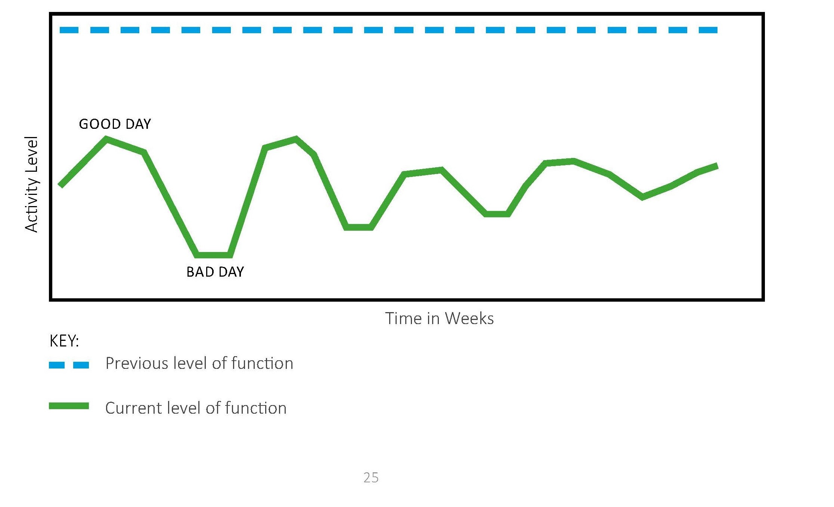
Thinking differently about activity – the over doer
Notes:
Tends to try and keep going and push through the pain, but then crashes
Do you identify with this?
What influences this – likes to get the job done, struggles to say no?
What are the consequences of this?

Slide 6
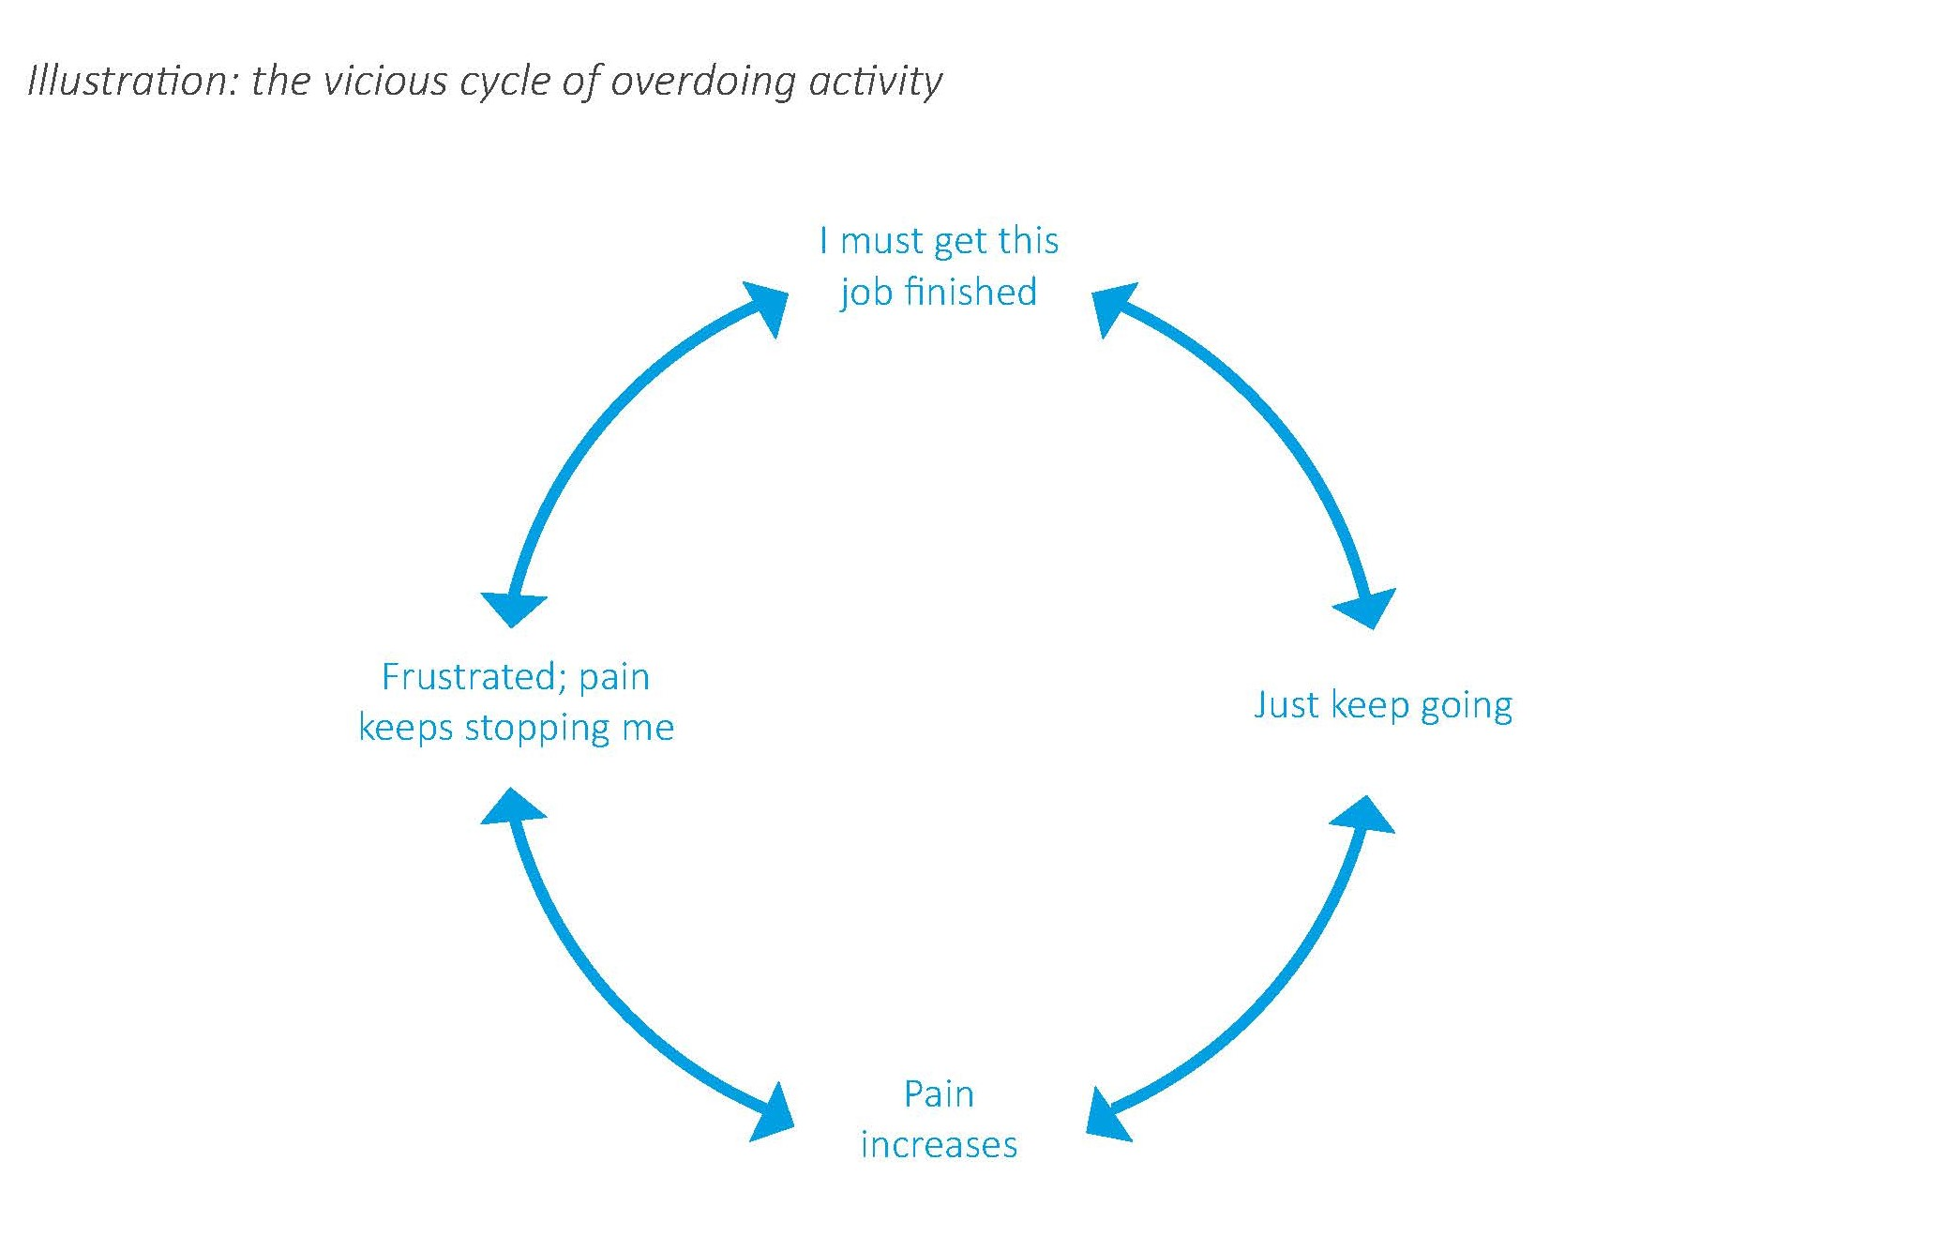

Slide 7
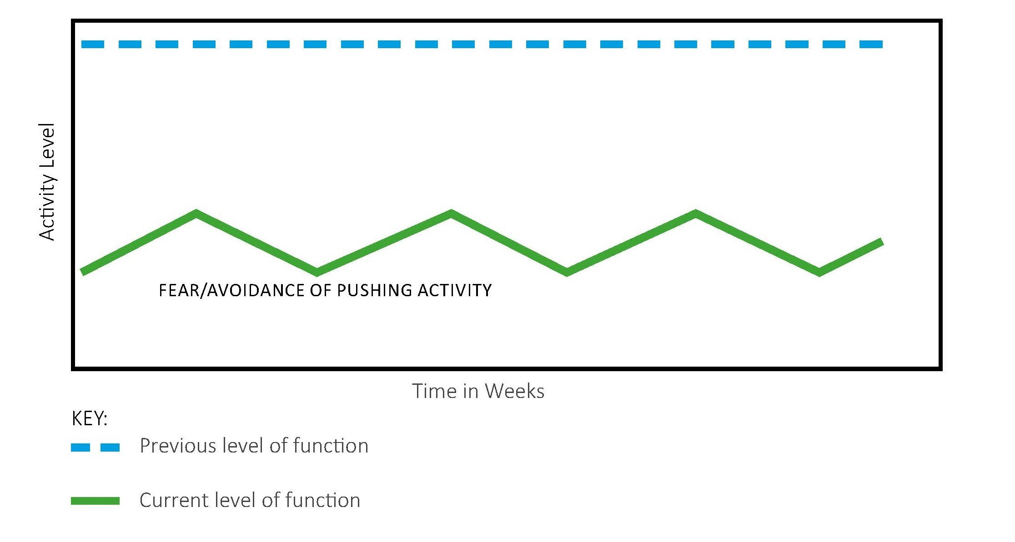
Thinking differently about activity – the avoider
Notes:
Tends to adapt or avoid activity in response to pain
Do you identify with this?
What influences this – pain, fear, worry about damage?
What are the consequences of this avoidance pattern?

Slide 8
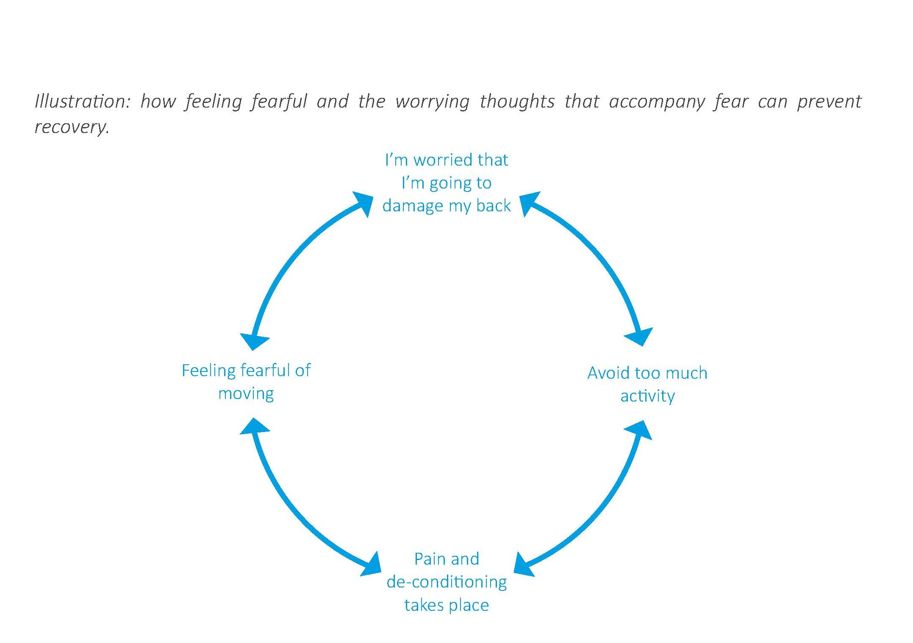

Slide 9
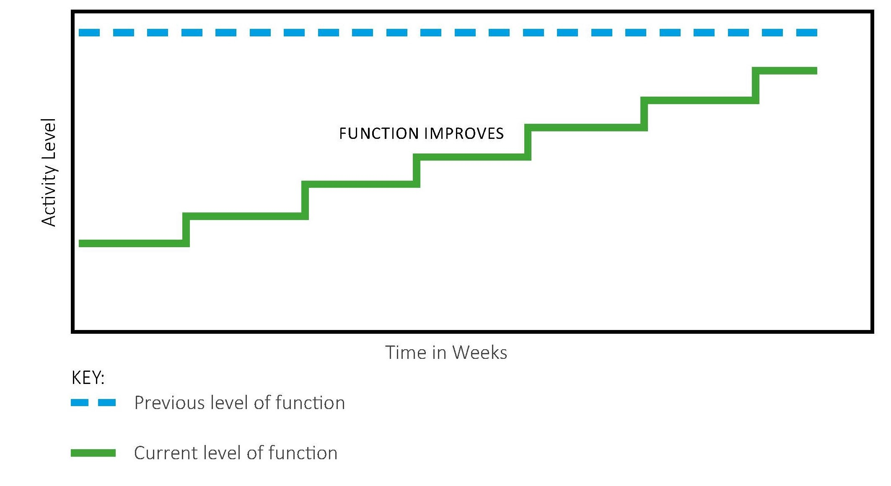
Graded activity – the key to recovery for avoiders
Notes:
What are the challenges of graded activity
How can I apply this in the real world if I tend to avoid?
Choose any activity
Work out how much you can do comfortably
Set a plan to build up activity
Expect to feel worse to begin with
Don’t over do it on a good day

Slide 10

Graded activity – the key to recovery for over doers
Notes:
What are the challenges of graded activity
How can I apply this in the real world if I tend to over do it?
Choose any activity
Work out how much you can do comfortably
Stop yourself when you know you are pushing too hard
Learn to say no, delegate, prioritise
Don’t over do it on a good day

Slide 11
Motion is lotion
5 exercises to help you recover
Notes:
One clinician leads this – the others observe movement patterns
Encourage patients to leave video function running – look for avoidant patterns or perfectionism
Facilitate a discussion regarding how these movements felt for patients, challenge any unhelpful beliefs

Slide 12
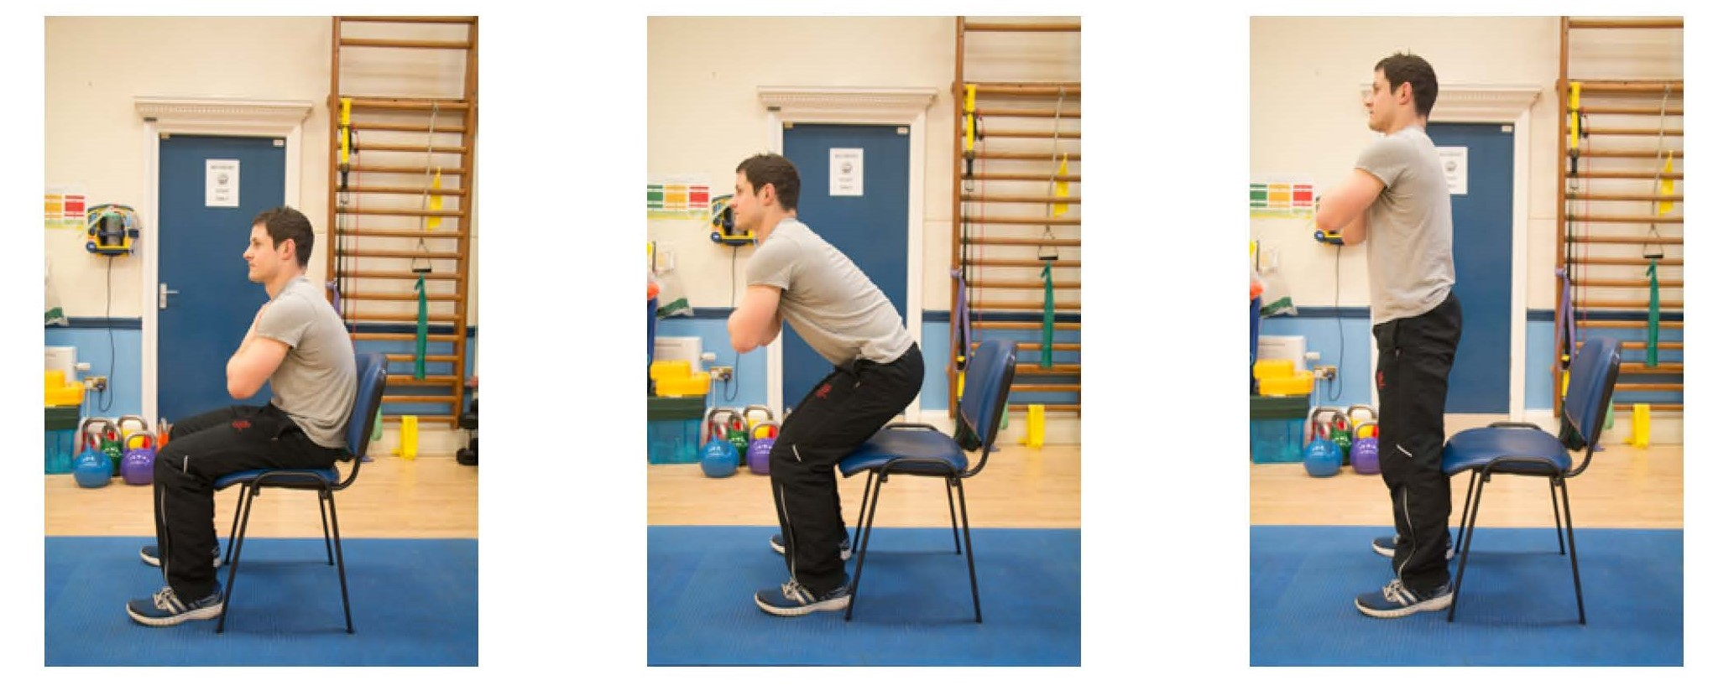
Sit to stand
Notes:
One clinician leads this – the others observe movement patterns
Encourage patients to leave video function running – look for avoidant patterns or perfectionism
Facilitate a discussion regarding how these movements felt for patients, challenge any unhelpful beliefs

Slide 13
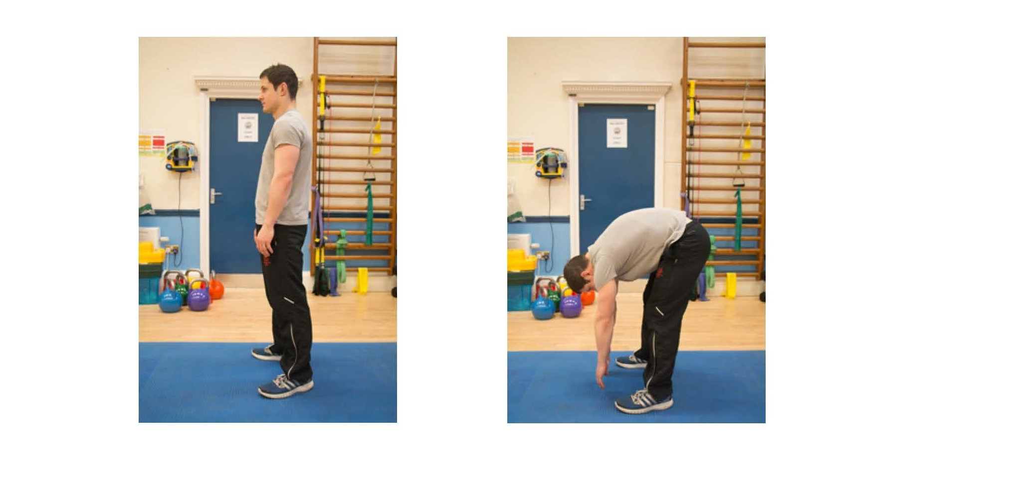
Forward bending
Notes:
One clinician leads this – the others observe movement patterns
Encourage patients to leave video function running – look for avoidant patterns or perfectionism
Facilitate a discussion regarding how these movements felt for patients, challenge any unhelpful beliefs

Slide 14
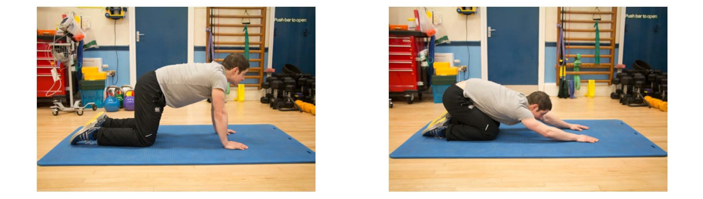
The CAT stretch
Notes:
One clinician leads this – the others observe movement patterns
Encourage patients to leave video function running – look for avoidant patterns or perfectionism
Facilitate a discussion regarding how these movements felt for patients, challenge any unhelpful beliefs

Slide 15
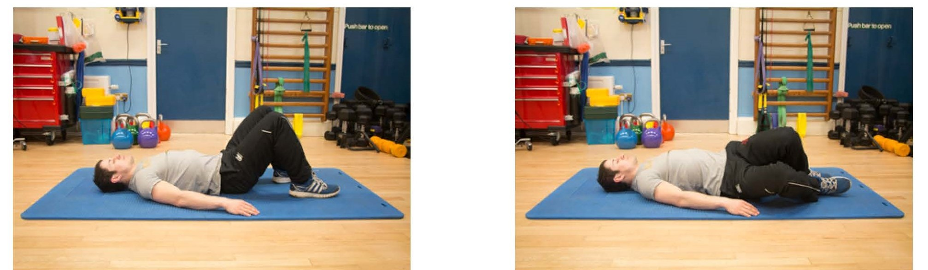
Knee rolling
Notes:
One clinician leads this – the others observe movement patterns
Encourage patients to leave video function running – look for avoidant patterns or perfectionism
Facilitate a discussion regarding how these movements felt for patients, challenge any unhelpful beliefs

Slide 16
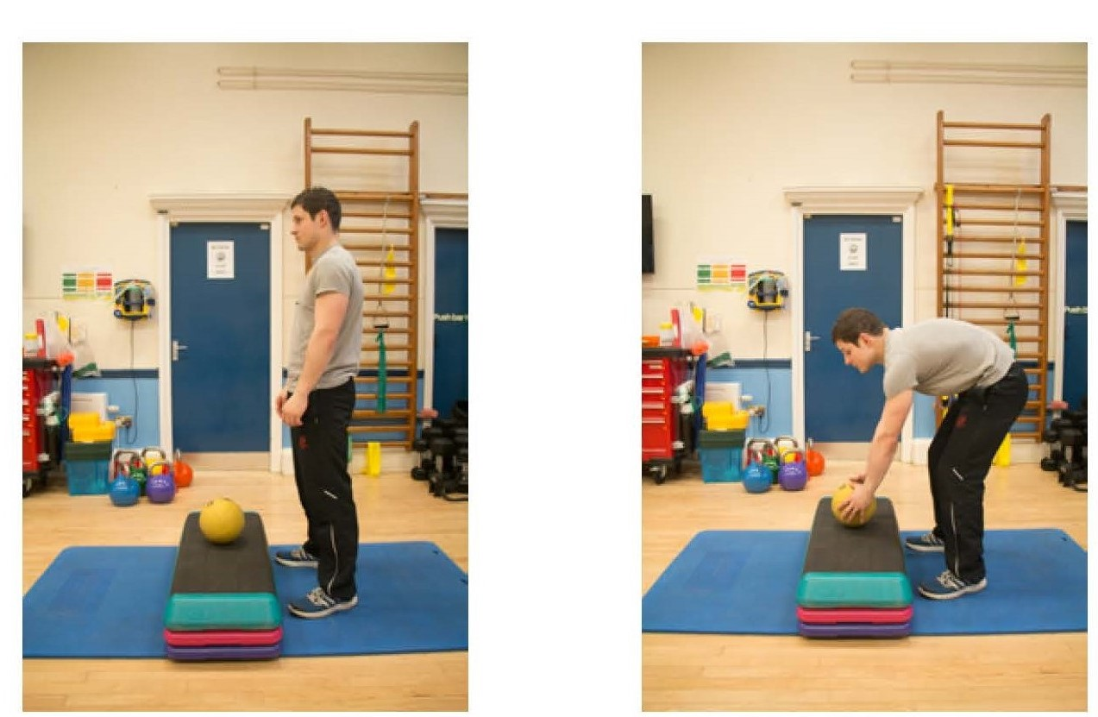
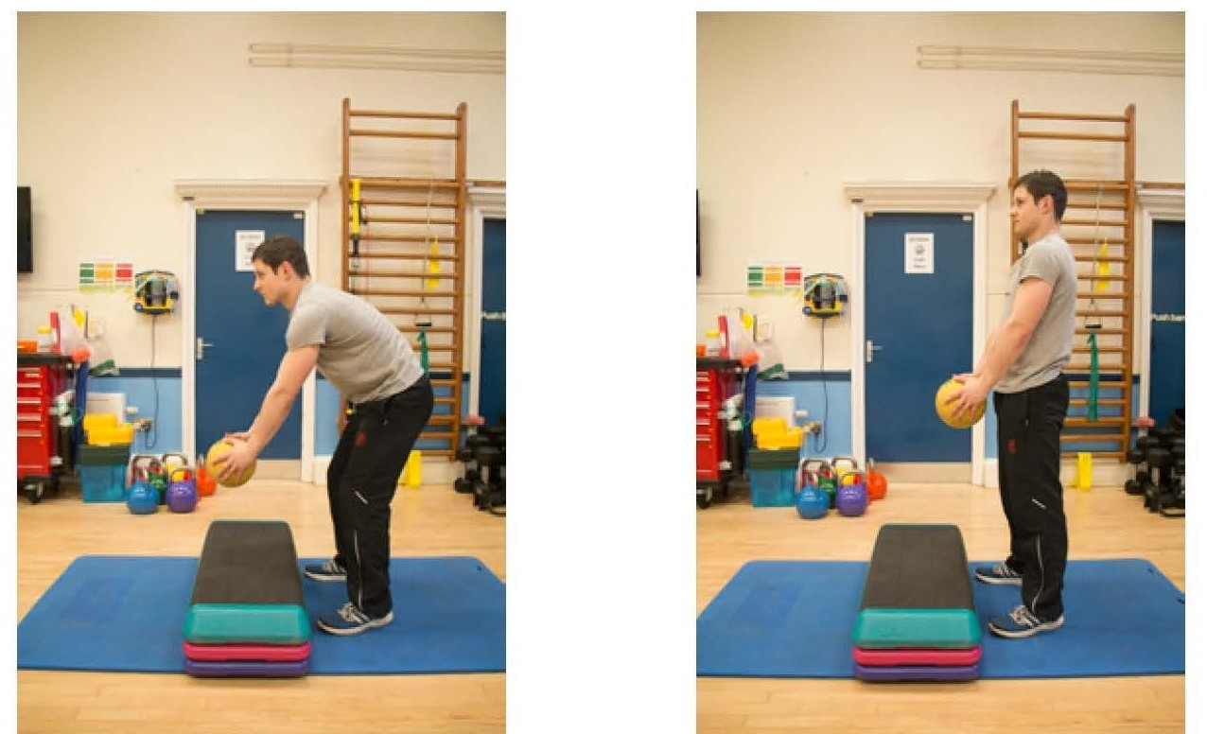
Bending and lifting
Notes:
One clinician leads this – the others observe movement patterns
Encourage patients to leave video function running – look for avoidant patterns or perfectionism
Facilitate a discussion regarding how these movements felt for patients, challenge any unhelpful beliefs

Slide 17
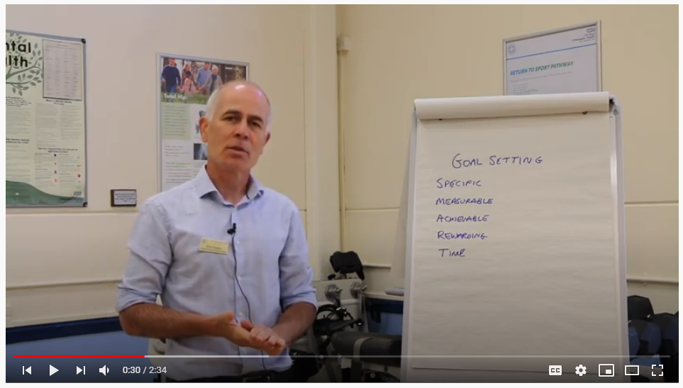
Goal setting
https://youtu.be/gdlgmh_FEAI

Slide 18
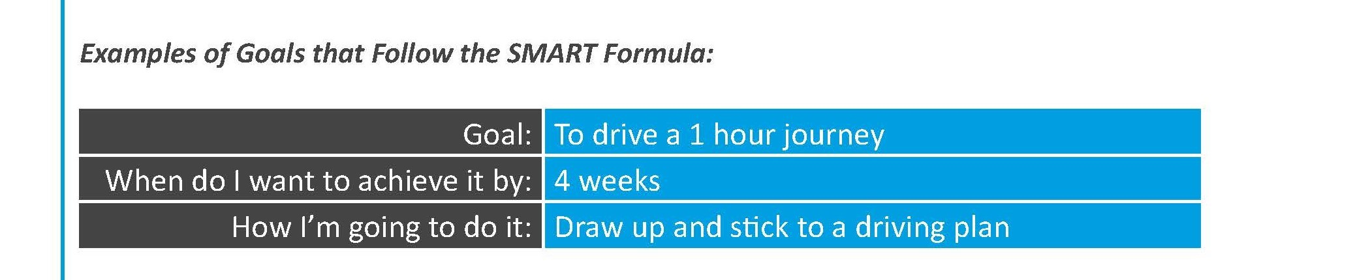
Notes:
SMART formula
Check your email
Email goals to team

Slide 19
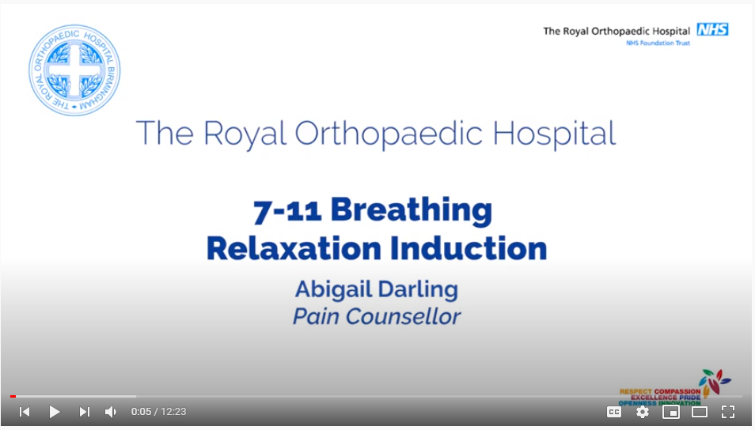
Time to relax
https://youtu.be/lszsXjozezU
Notes:
A practical session on some simple relaxation techniques patients find helpful as part of their toolkit
The relaxation response
Triggered by:
Perception of a lack of threat
Sense of safety through social contact
Pleasant emotions
Achieving goals
Solving problems
Active relaxation exercises, i.e. 7-11 breathing
Take in a deep breath (for the count of 7)
Hold briefly
Release slowly (for the count of 11)
Empty the lungs
Pause
Repeat

Slide 20
Summary of session
Notes:
Individual phone call to discuss session

Slide 21
Personal time
Individual phone call to discuss session

Slide 22


