Slide 1


Back to Life
Session 3:
Combining Physical and Psychological Treatment for back pain

Slide 2
Review of last week
Activity management
Graded activity
Finding a baseline
Goal setting

Slide 3
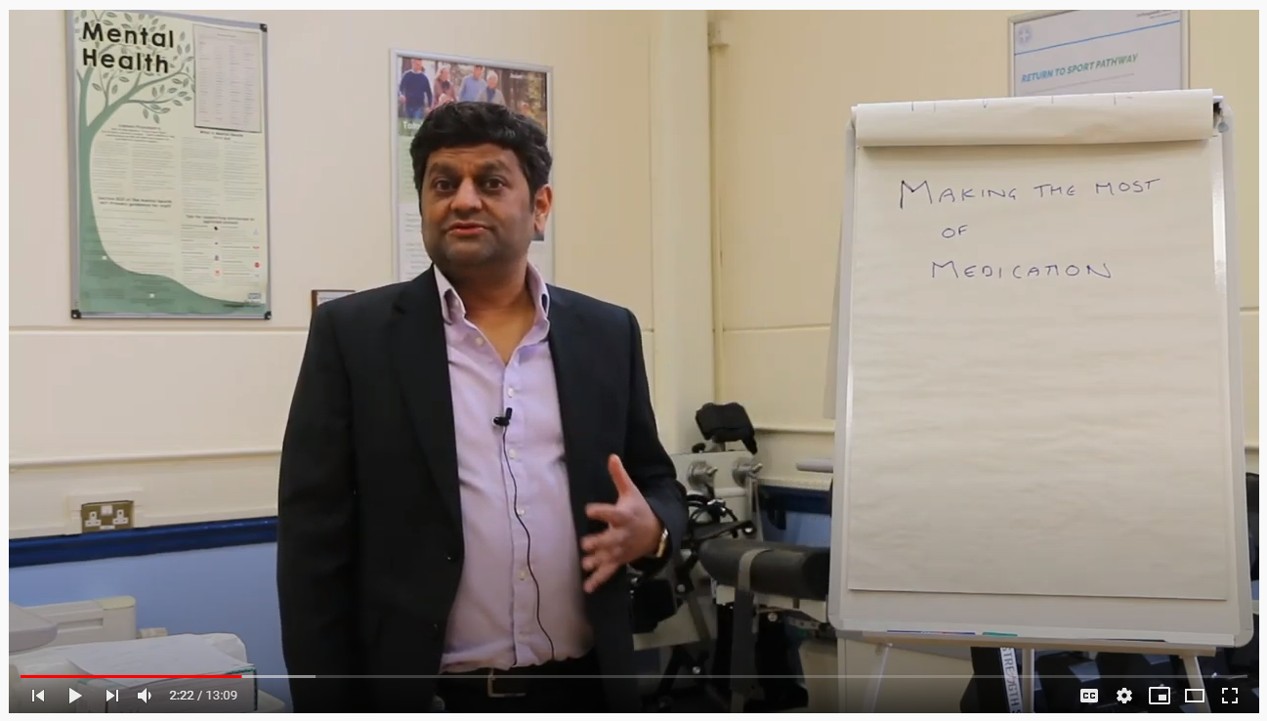
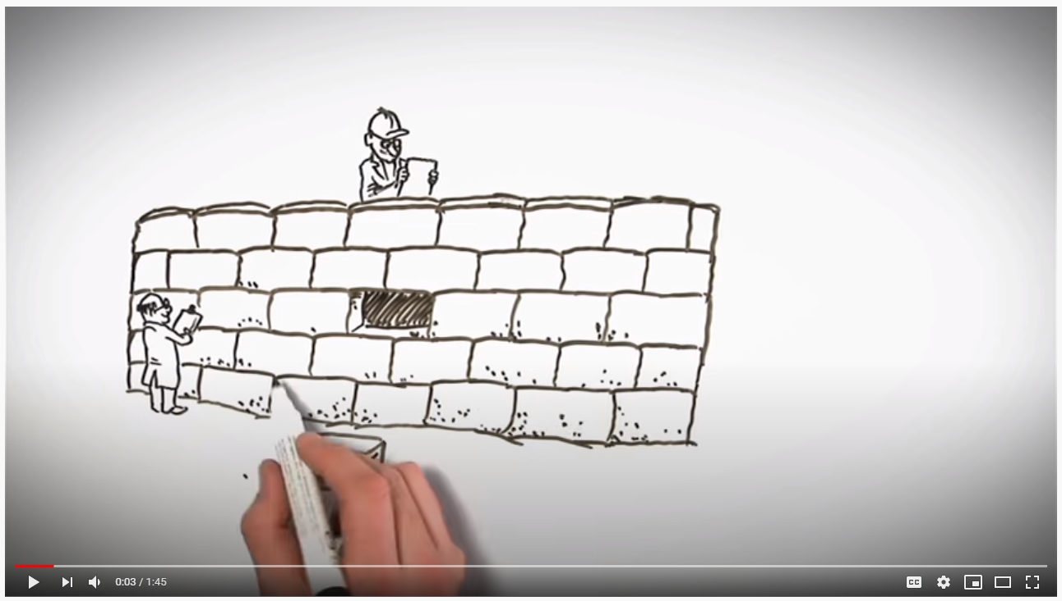
Getting the best out of medication
https://youtu.be/Xlsq8jEFmUk
https://youtu.be/MI1myFQPdCE
Notes:
Don’t offer feedback option – this is an education session

Slide 4
Group exercise – goal setting
Notes:
Relate goal setting to the activity management talk
Review how avoidance or boom/bust behaviour is unlikely to assist you in achieving your goals
Focus on ensuring goals are rewarding
Sharing goals with team
How will you plan to achieve your goal
Problem solving
Should we do this as a small group exercise

Slide 5
Motion is lotion
Five more exercises to help you recover:

Slide 6
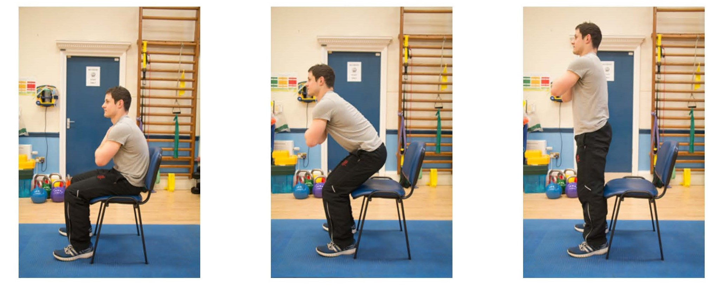
Sit to stand
Notes:
One clinician leads this – the others observe movement patterns
Encourage patients to leave video function running – look for avoidant patterns or perfectionism
Facilitate a discussion regarding how these movements felt for patients, challenge any unhelpful beliefs

Slide 7
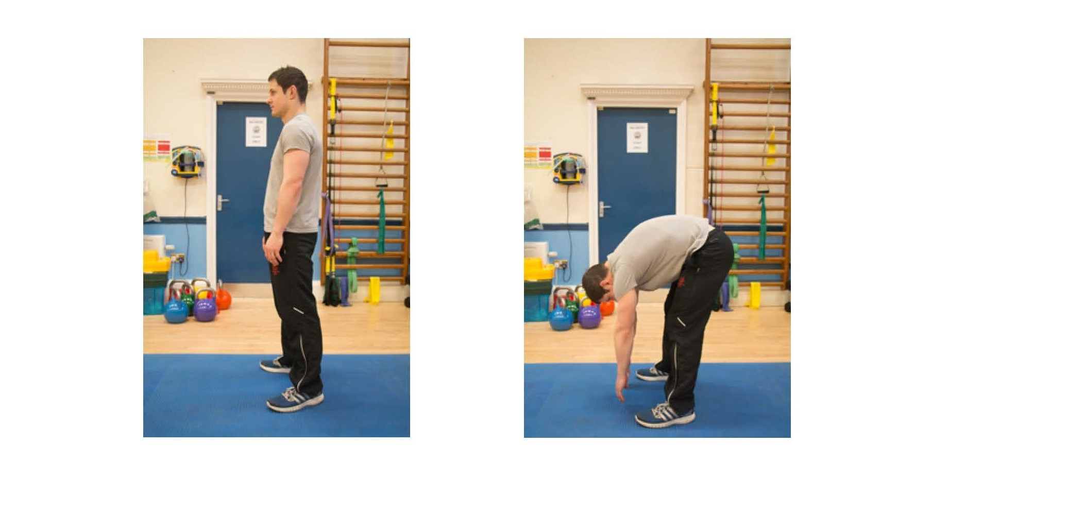
Forward bending
Notes:
One clinician leads this – the others observe movement patterns
Encourage patients to leave video function running – look for avoidant patterns or perfectionism
Facilitate a discussion regarding how these movements felt for patients, challenge any unhelpful beliefs

Slide 8
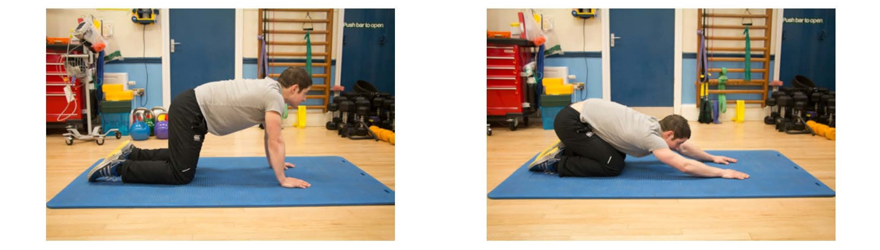
The CAT stretch
Notes:
One clinician leads this – the others observe movement patterns
Encourage patients to leave video function running – look for avoidant patterns or perfectionism
Facilitate a discussion regarding how these movements felt for patients, challenge any unhelpful beliefs

Slide 9
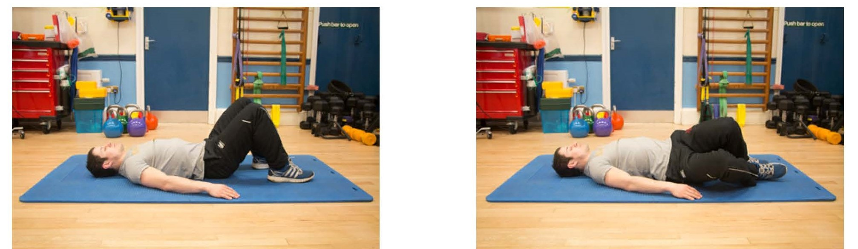
Knee rolling
Notes:
One clinician leads this – the others observe movement patterns
Encourage patients to leave video function running – look for avoidant patterns or perfectionism
Facilitate a discussion regarding how these movements felt for patients, challenge any unhelpful beliefs

Slide 10
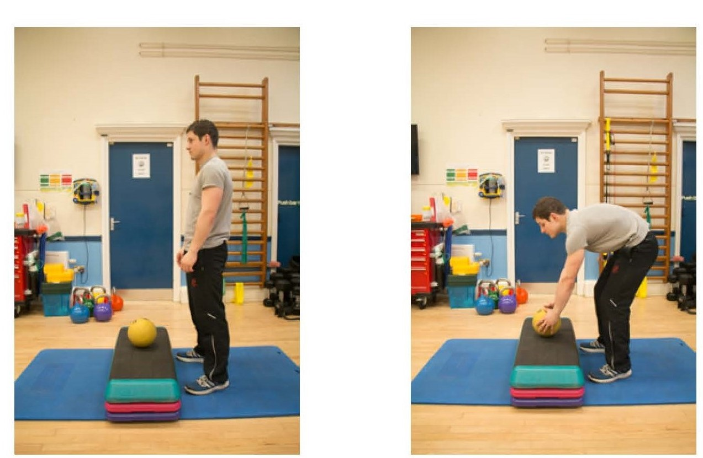
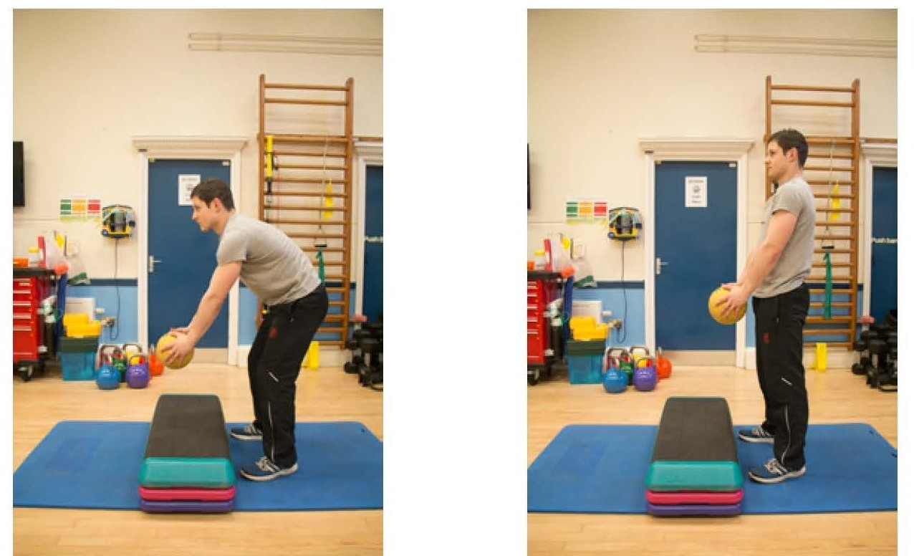
Bending and lifting
Notes:
One clinician leads this – the others observe movement patterns
Encourage patients to leave video function running – look for avoidant patterns or perfectionism
Facilitate a discussion regarding how these movements felt for patients, challenge any unhelpful beliefs

Slide 11
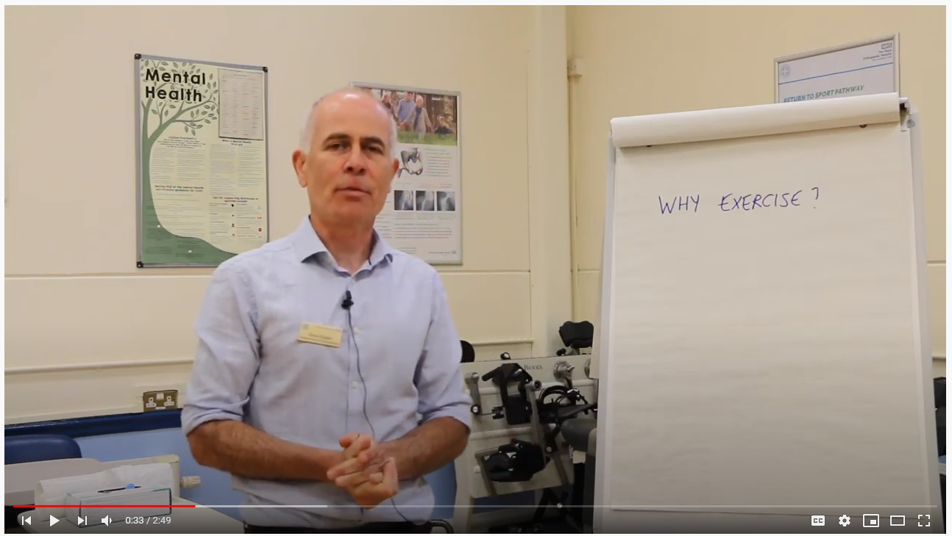
What does exercise do to the body?
https://youtu.be/xvuSBwf1mIg
Notes:
discussion around benefits of exercise
Myth-busting – are there any do’s and don’t with exercise
Is exercise safe?
Aerobic activity – walking, cycling, swimming
Strength training – what can I do?
Stretching - where do I start?
Complete a 20 minute aerobic exercise such as walking 3 times per week

Slide 12
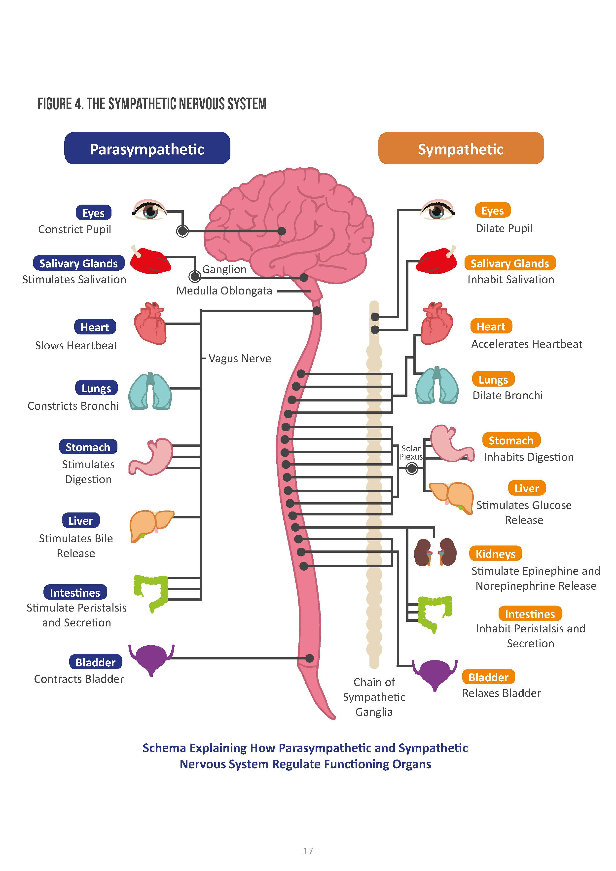
How does relaxation help back pain?
Video link here Pete –
Notes:
Facilitate a discussion around the concept of safe exercise – explore unhelpful beleifs, fear avoidance, low self efficacy
Introduce the role that aerobic activity can play in their recovery – free movement, strengthening dormant pathways, muscles, cardiovascular fitness, benefits to toher health complaints
The role that strength training can play – increased stamina, increased function, reduced fear
Reflect on stretches, the evidence behind the value of yoga
Set some targets for patients in relation to aerobic activity for the next 5 weeks

Slide 13
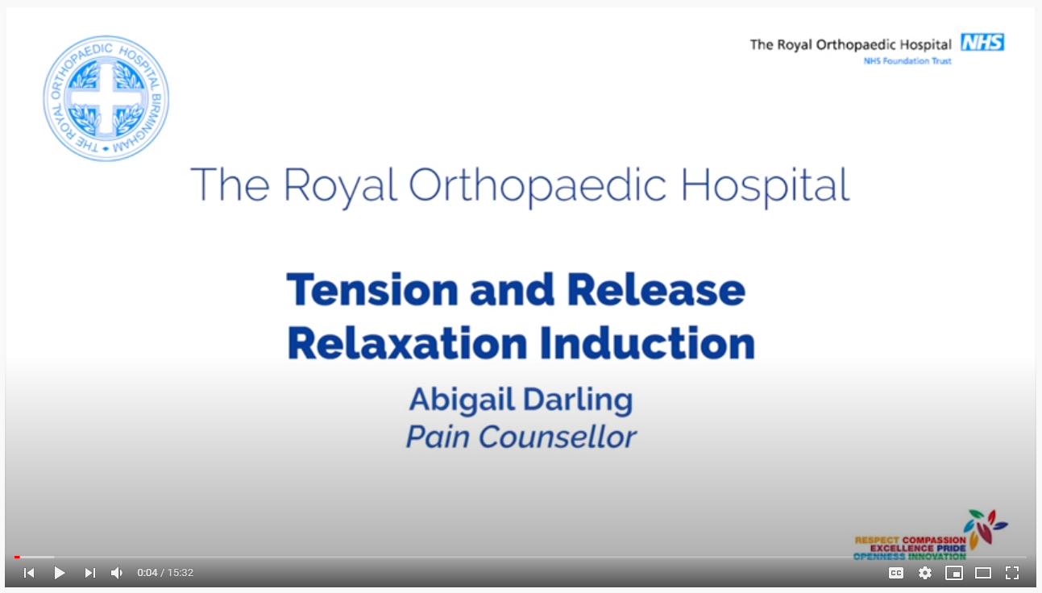
Time to relax
https://youtu.be/BXSsTFY0y5U
Notes:
Facilitate a discussion around the concept of safe exercise – explore unhelpful beleifs, fear avoidance, low self efficacy
Introduce the role that aerobic activity can play in their recovery – free movement, strengthening dormant pathways, muscles, cardiovascular fitness, benefits to toher health complaints
The role that strength training can play – increased stamina, increased function, reduced fear
Reflect on stretches, the evidence behind the value of yoga
Set some targets for patients in relation to aerobic activity for the next 5 weeks

Slide 14
Summary of session
Notes:
Individual phone call to discuss session

Slide 15
Personal time

Slide 16


