Slide 1


Back to Life
Session 5:
Combining Physical and Psychological Treatment for back pain

Slide 2
Review of last week
Have I found any sleep strategies helpful
What triggers lead to my flare-ups
Have I been working on my flare-up plan

Slide 3
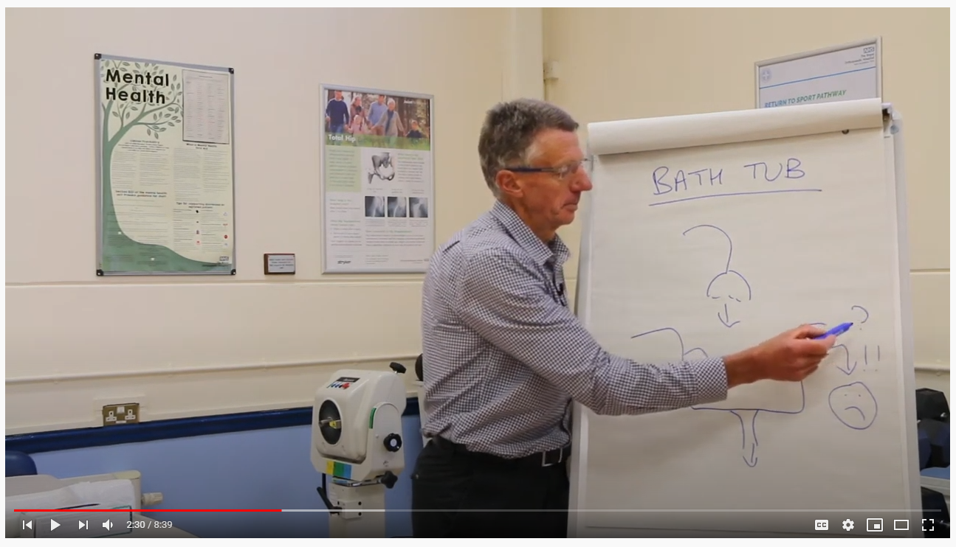
The overflowing bathtub
Neuro-muscular tension activating nociception
Explanation video
https://youtu.be/YNMuydZmzIk

Slide 4
The overflowing bathtub
Do not understand pain?
Fear the worst!!
Neuro-muscular tension activating nociception
PAIN EXPERIENCE

Slide 5
The overflowing bathtub
Negative life events:
Loss
Bereavement
Trauma
Illness
Strong emotions:
Anger
Grief
Depression
Anxiety
PTSD
Behaviours:
Avoidant
Boom-Bust
Poor quality sleep
Attention:
Over focus on symptoms & passive treatment
Medical:
Unhelpful messages & labels
Feeling disbelieved
Do not understand pain?
Fear the worst!!
Neuro-muscular tension activating nociception
PAIN EXPERIENCE

Slide 6
The overflowing bathtub
Negative life events:
Loss
Bereavement
Trauma
Illness
Strong emotions:
Anger
Grief
Depression
Anxiety
PTSD
Behaviours:
Avoidant
Boom-Bust
Poor quality sleep
Attention:
Over focus on symptoms & passive treatment
Medical:
Unhelpful messages & labels
Feeling disbelieved
Do not understand pain?
Fear the worst!!
Neuro-muscular tension activating nociception
PAIN EXPERIENCE
Understanding my pain & taking back control
Slow inflow: modify or acceptance
Pleasurable activity and exercise
Focus attention away from symptoms
Deep relaxation
Mindfulness practice
Quality sleep
Fun and laughter

Slide 7
Bath-tub reflective exercise
Remember persistent pain can be influenced by many different things
Negative life events, external pressures, overload
Spend a few moments drawing your own bath-tub
Consider what things specific to your own life may be contributing to ongoing pain
Should we do this in pairs with a worksheet?
Notes:
Remember persistent pain can be influenced by many different things
Negative life events, external pressures, overload
Spend a few moments drawing your own bath-tub
Consider what things specific to your own life may be contributing to ongoing pain

Slide 8
Motion is lotion
5 more exercises to help you recover:

Slide 9
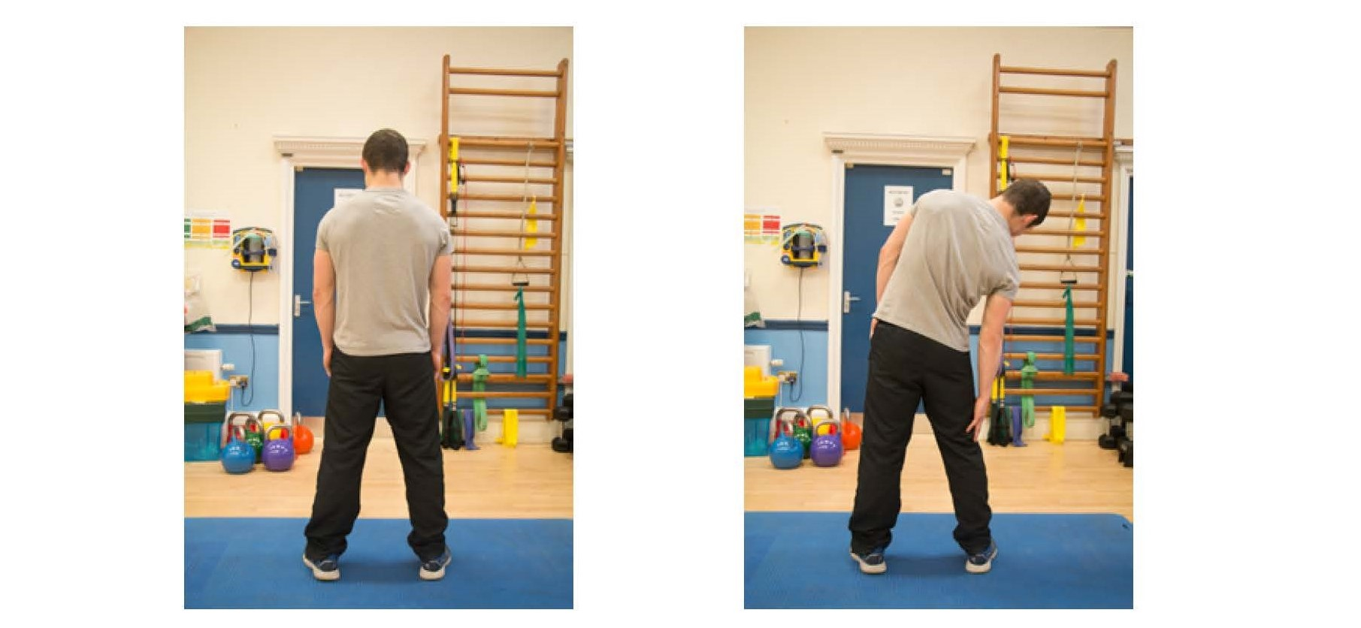
Lateral flexion
Notes:
One clinician leads this – the others observe movement patterns
Encourage patients to leave video function running – look for avoidant patterns or perfectionism
Facilitate a discussion regarding how these movements felt for patients, challenge any unhelpful beliefs

Slide 10
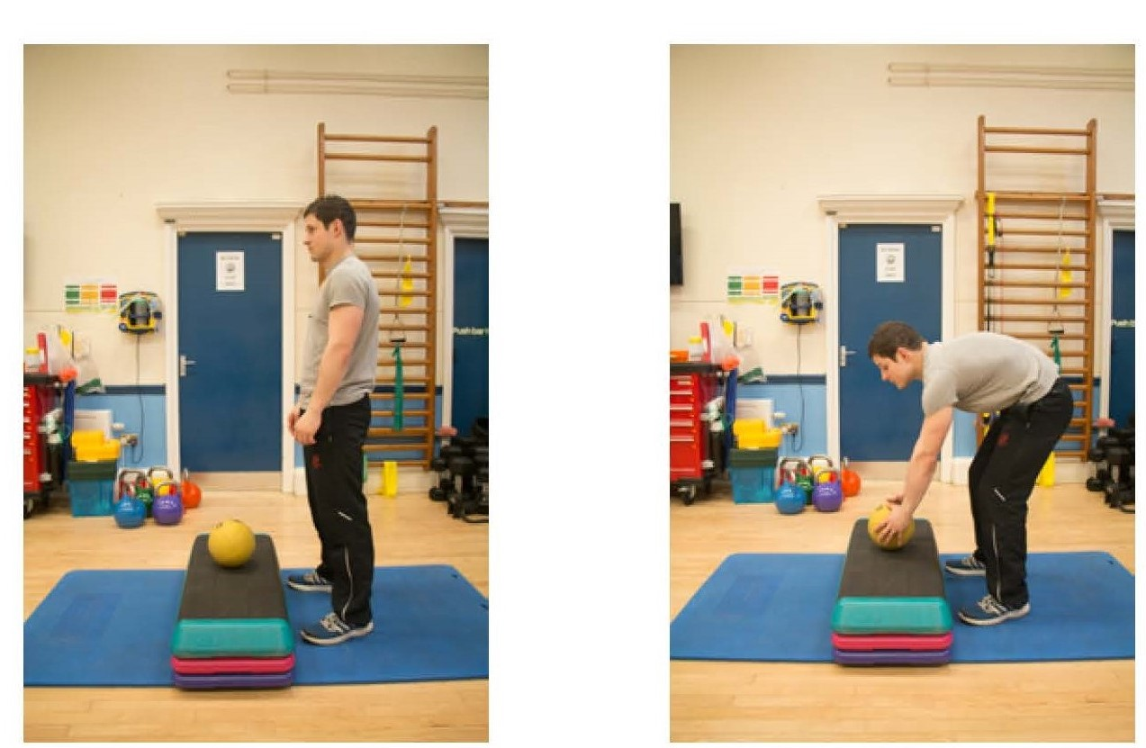
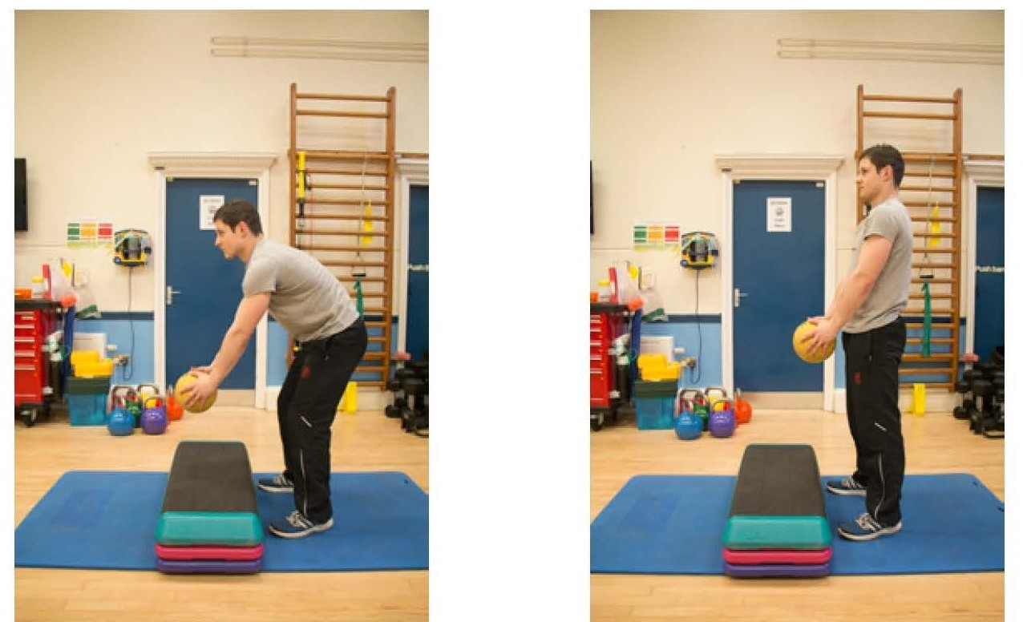
Bending and lifting
Notes:
One clinician leads this – the others observe movement patterns
Encourage patients to leave video function running – look for avoidant patterns or perfectionism
Facilitate a discussion regarding how these movements felt for patients, challenge any unhelpful beliefs

Slide 11
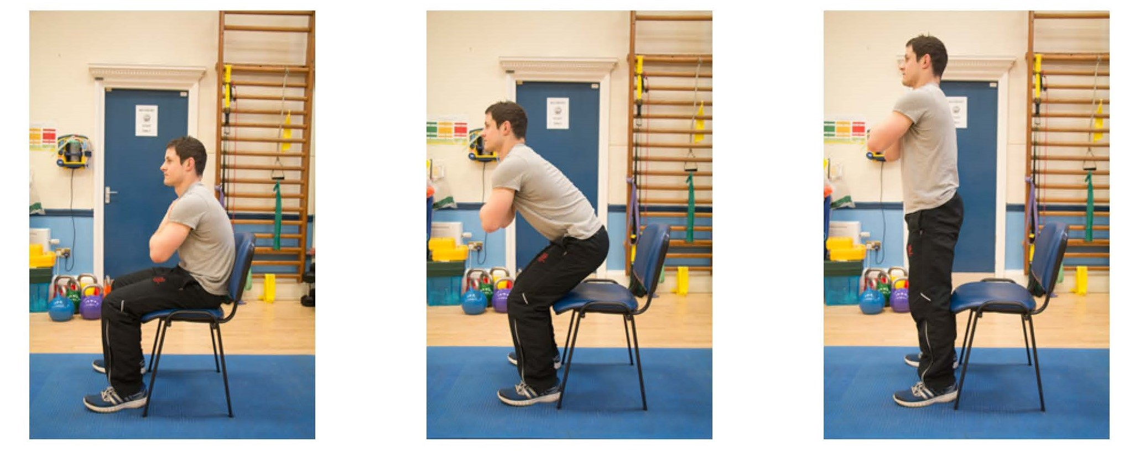
Sit to stand
Notes:
One clinician leads this – the others observe movement patterns
Encourage patients to leave video function running – look for avoidant patterns or perfectionism
Facilitate a discussion regarding how these movements felt for patients, challenge any unhelpful beliefs

Slide 12
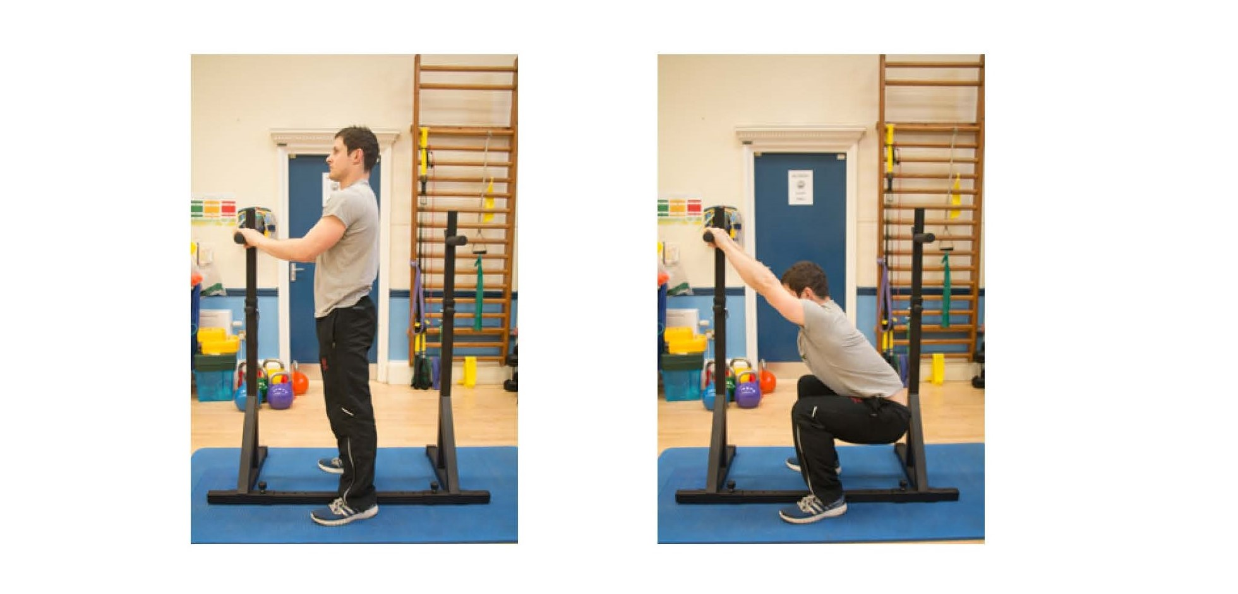
Deep squat

Slide 13
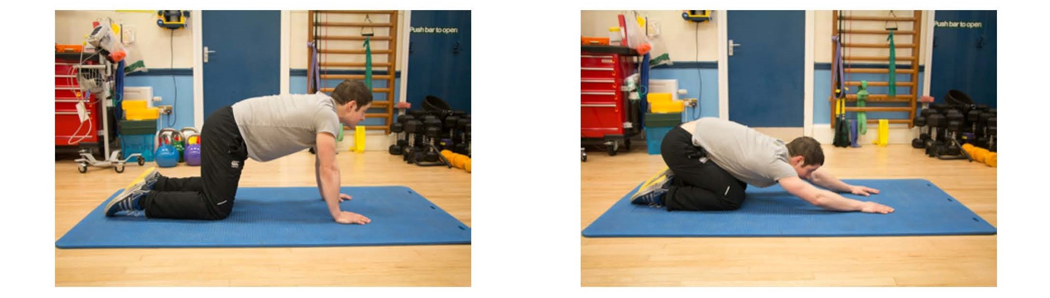
The CAT stretch
Notes:
One clinician leads this – the others observe movement patterns
Encourage patients to leave video function running – look for avoidant patterns or perfectionism
Facilitate a discussion regarding how these movements felt for patients, challenge any unhelpful beliefs

Slide 14
Reviewing the journey so far
Notes:
Understanding pain
Activity management – learning to say no
Finding a baseline and graded activity
Getting the best out of medication
Improving your sleep
Managing flare-ups effectively

Slide 15
Review of goals
Break out session in pairs
Notes:
pairs – what is going well, what are you struggling with, how are you progressing?
Are you finding time to focus on your goals?
Are there any obstacles to you achieving your goals?

Slide 16
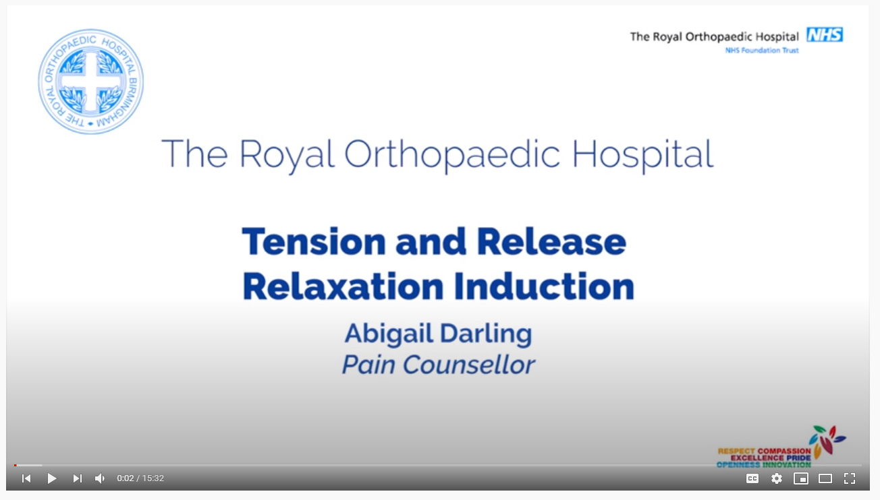
Time to relax
https://youtu.be/BXSsTFY0y5U
Notes:
Facilitate a discussion around the concept of safe exercise – explore unhelpful beleifs, fear avoidance, low self efficacy
Introduce the role that aerobic activity can play in their recovery – free movement, strengthening dormant pathways, muscles, cardiovascular fitness, benefits to toher health complaints
The role that strength training can play – increased stamina, increased function, reduced fear
Reflect on stretches, the evidence behind the value of yoga
Set some targets for patients in relation to aerobic activity for the next 5 weeks

Slide 17
Summary of session
Notes:
Individual phone call to discuss session

Slide 18
Personal time

Slide 19


