Slide 1


Back to Life
Session 4:
Combining Physical and Psychological Treatment for back pain

Slide 2
Review of last week
Notes:
Am I getting the best out of prescribed medication?
What’s been my experience of using the relaxation exercises?
Have I found the right level of exercise so far – aerobic, stretching, strengthening?
Do I have a clear baseline?
Am I using a graded approach to activity?

Slide 3
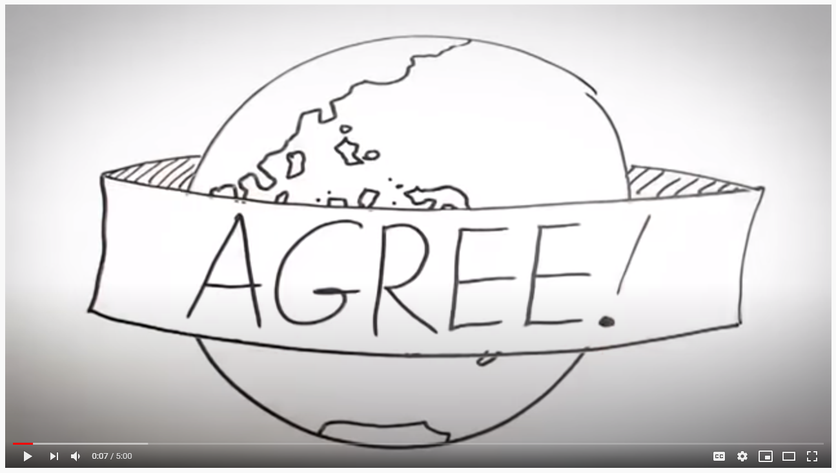
Halfway group review
https://youtu.be/C_3phB93rvI
Notes:
Facilitate a discussion around the concept of safe exercise – explore unhelpful beliefs, fear avoidance, low self efficacy
Introduce the role that aerobic activity can play in their recovery – free movement, strengthening dormant pathways, muscles, cardiovascular fitness, benefits to toher health complaints
The role that strength training can play – increased stamina, increased function, reduced fear
Reflect on stretches, the evidence behind the value of yoga
Set some targets for patients in relation to aerobic activity for the next 5 weeks
What changes are you noticing since beginning the programme?
Are there any challenges to implementing changes?

Slide 4
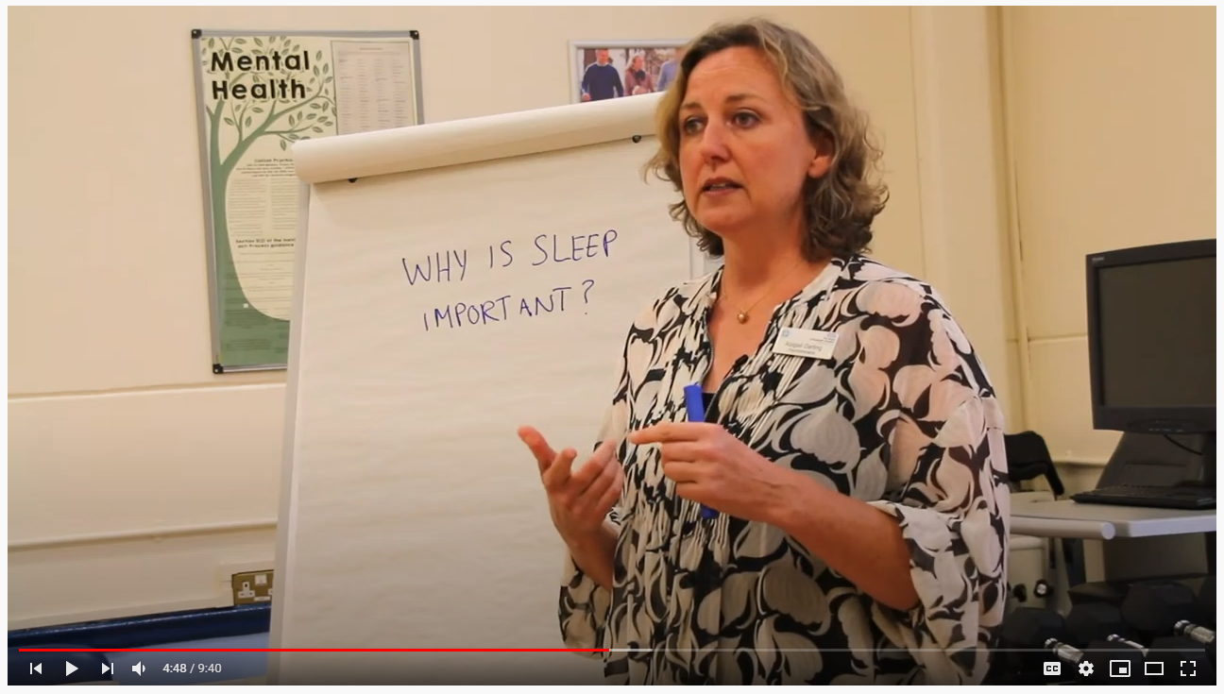
Why can sleep be such a problem when we are in pain
https://youtu.be/IpjTn2fAxOc

Slide 5
Reflecting on our sleep ability patterns
Notes:
What do we do already to help with our sleep?
What new ideas can we implement?
What may prevent us from implementing these new ideas?

Slide 6
Motion is lotion
5 more exercises to help you recover:

Slide 7
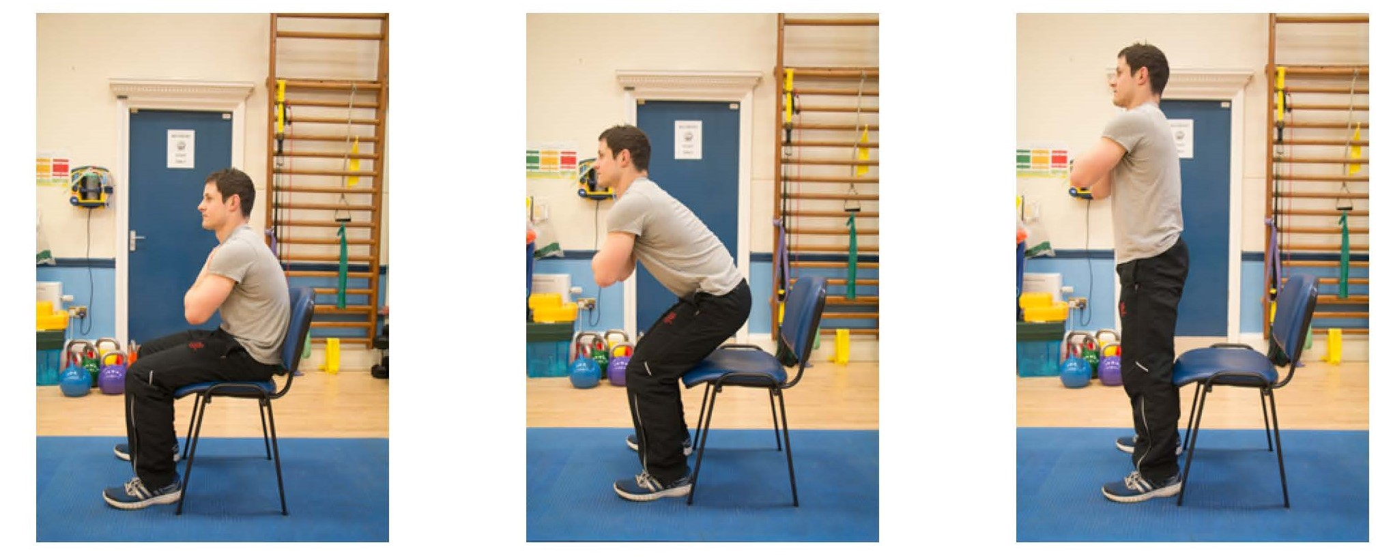
Sit to stand
Notes:
One clinician leads this – the others observe movement patterns
Encourage patients to leave video function running – look for avoidant patterns or perfectionism
Facilitate a discussion regarding how these movements felt for patients, challenge any unhelpful beliefs

Slide 8
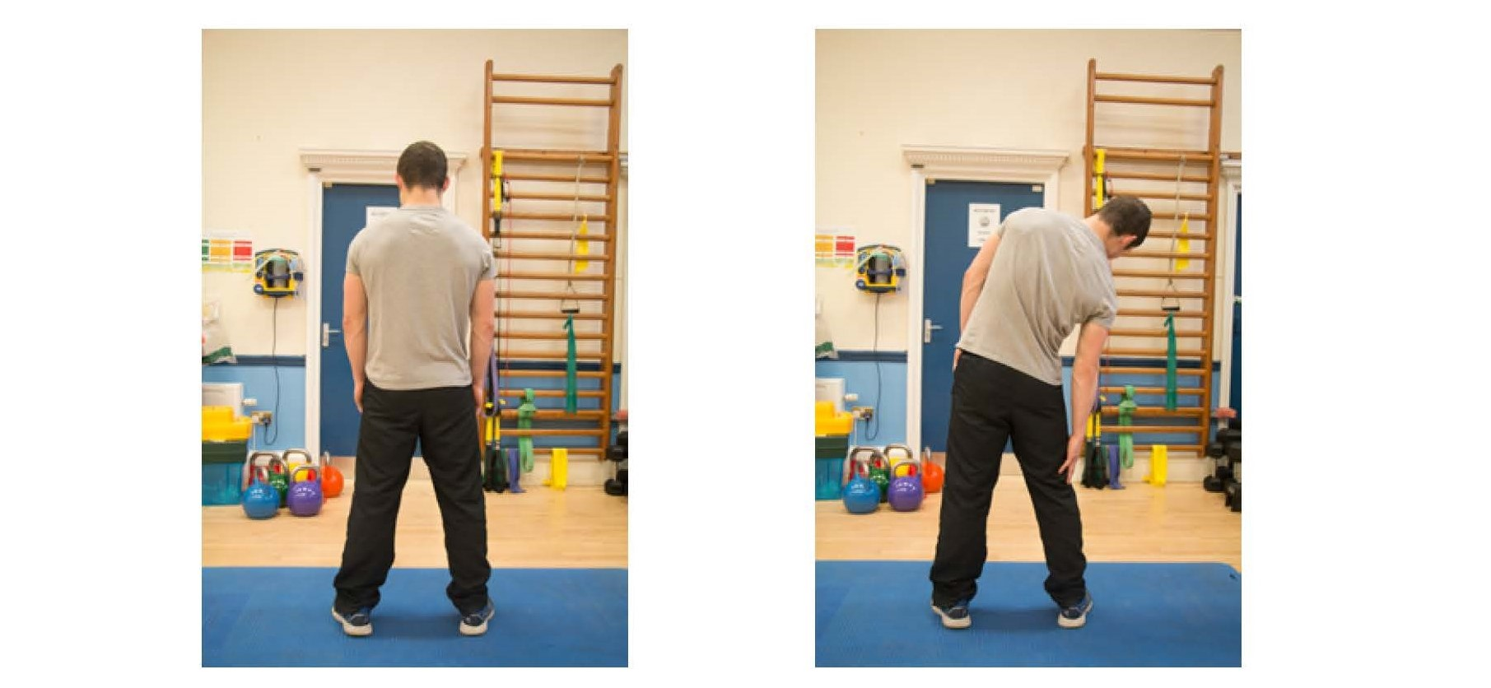
Lateral flexion
Notes:
One clinician leads this – the others observe movement patterns
Encourage patients to leave video function running – look for avoidant patterns or perfectionism
Facilitate a discussion regarding how these movements felt for patients, challenge any unhelpful beliefs

Slide 9
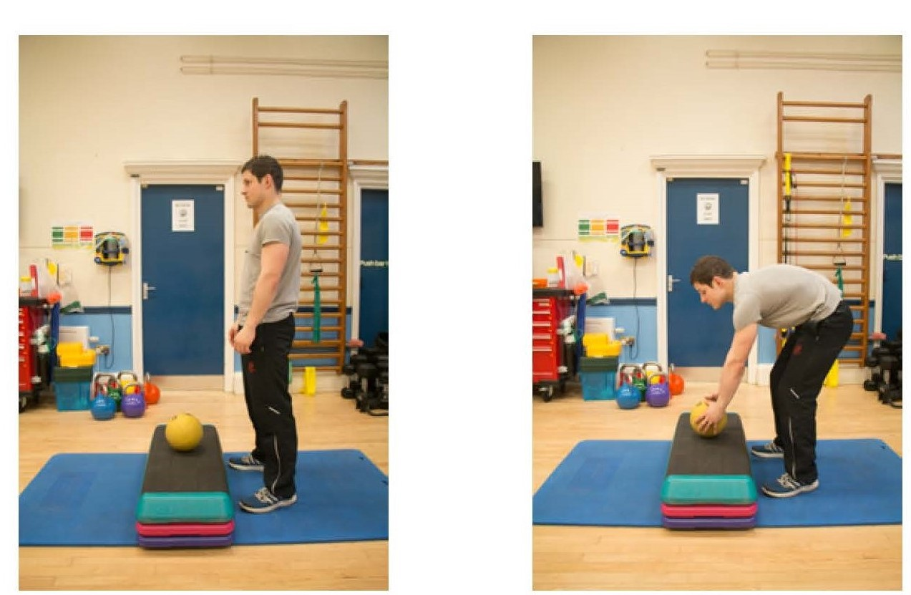
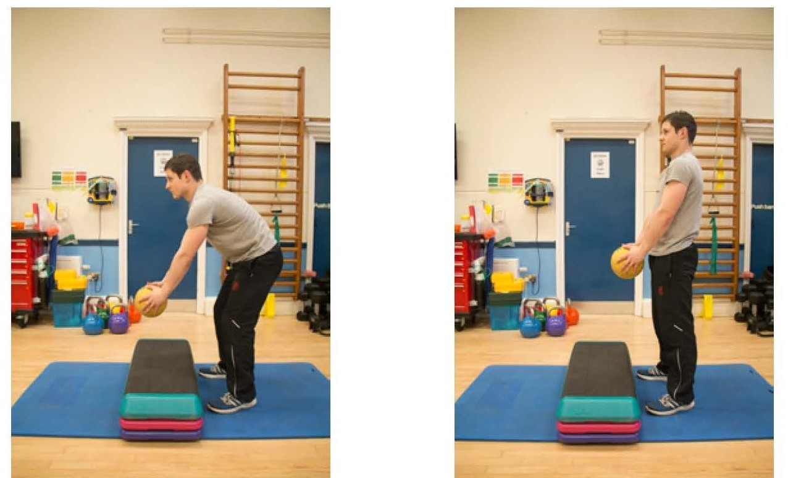
Bending and lifting
Notes:
One clinician leads this – the others observe movement patterns
Encourage patients to leave video function running – look for avoidant patterns or perfectionism
Facilitate a discussion regarding how these movements felt for patients, challenge any unhelpful beliefs

Slide 10
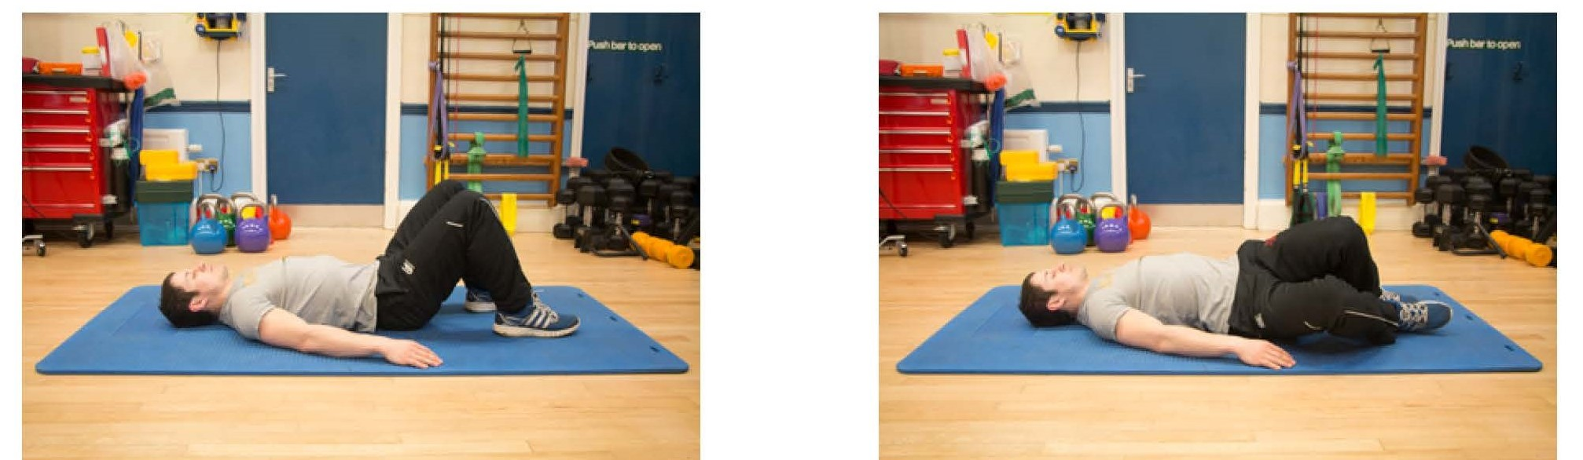
Knee rolling
Notes:
One clinician leads this – the others observe movement patterns
Encourage patients to leave video function running – look for avoidant patterns or perfectionism
Facilitate a discussion regarding how these movements felt for patients, challenge any unhelpful beliefs

Slide 11
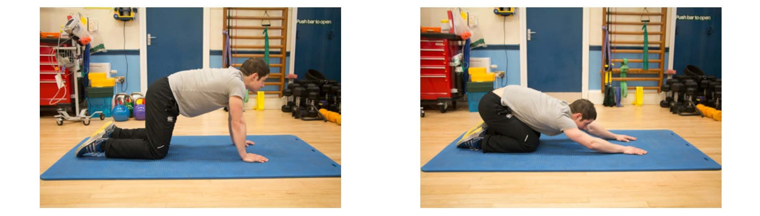
The CAT stretch
Notes:
One clinician leads this – the others observe movement patterns
Encourage patients to leave video function running – look for avoidant patterns or perfectionism
Facilitate a discussion regarding how these movements felt for patients, challenge any unhelpful beliefs

Slide 12
What triggers my flare-ups
Life events
BIGGER PICTURE?
Pete – flare-ups video here
Environment
Personal traits
Notes:
1. Thoughts: catastrophising, negative thinking,
2. Emotions: anger, guilt, sadness
3. Behaviour: activity level - do I push myself too hard sometimes/have I been doing less?
sleep quality
Environment:
Work/home
Children
Personal traits:
Perseverers/avoiders
Strugglers/jugglers
Life events:
Transitions
Trauma
Conflict
Loss

Slide 13
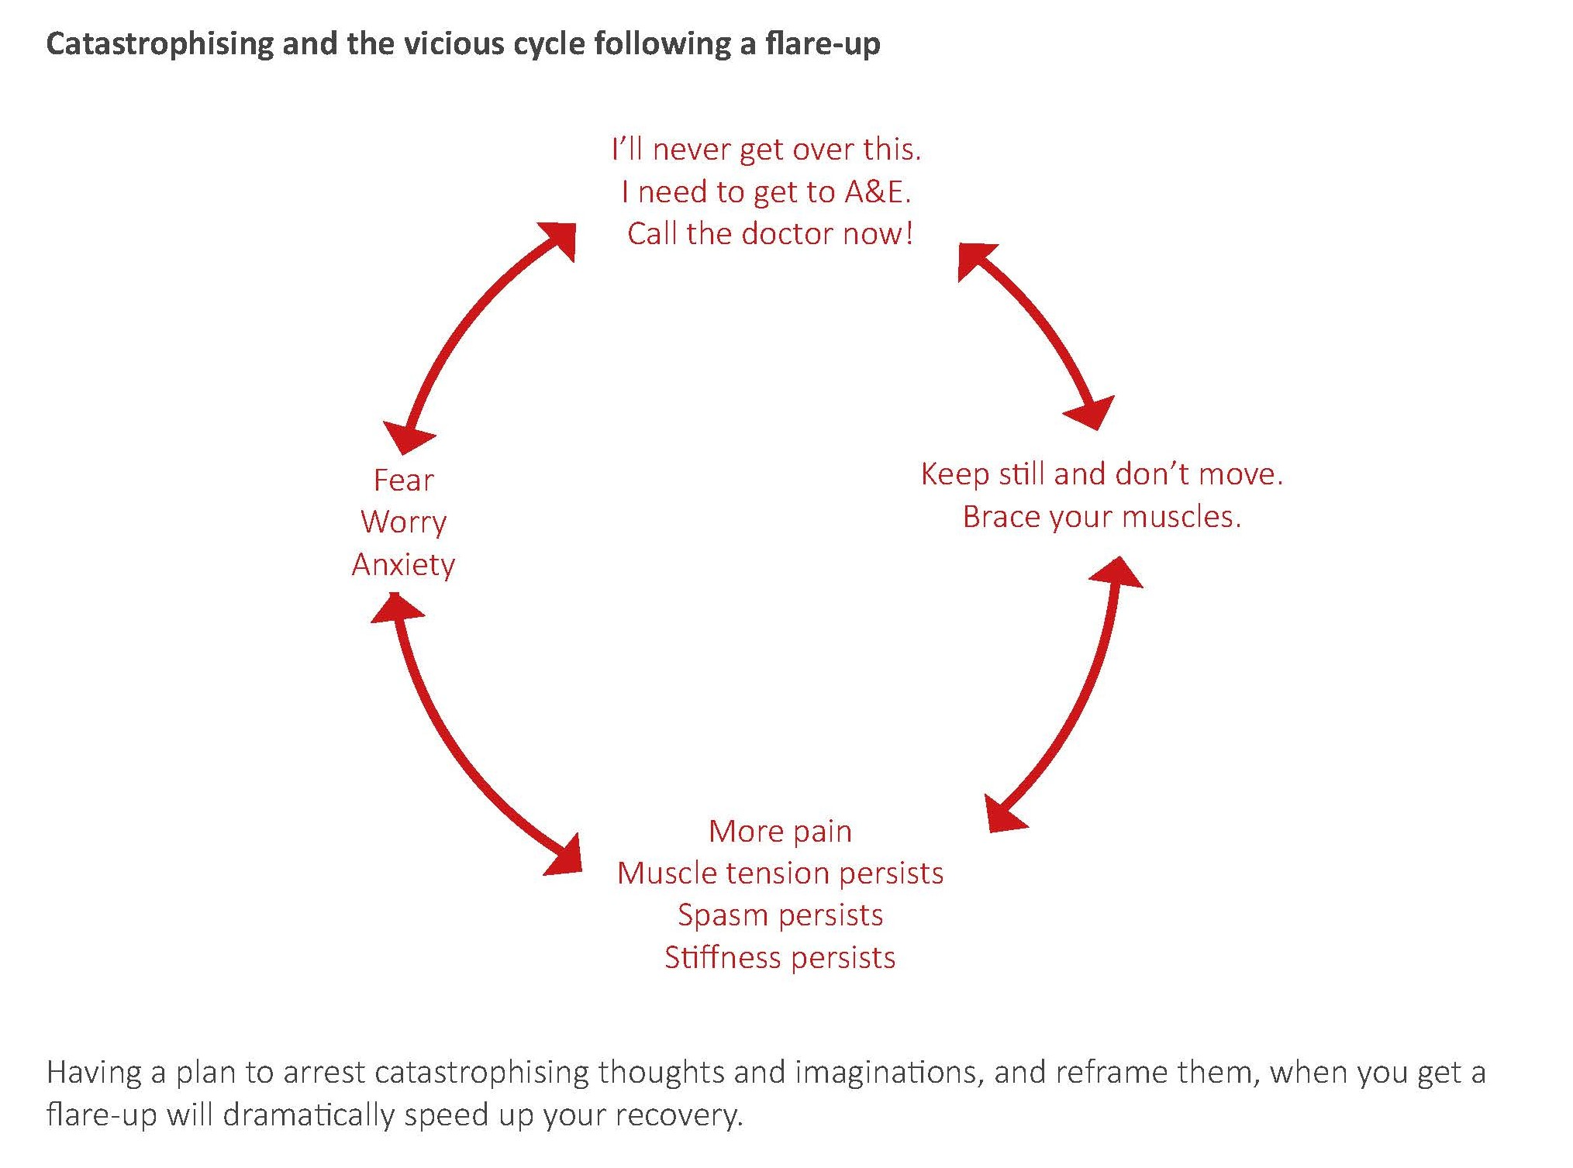
Thinking about thinking

Slide 14
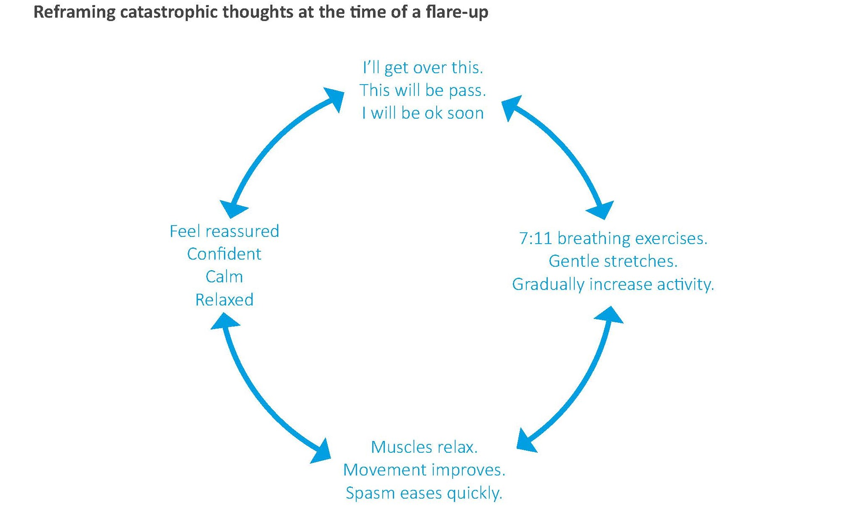

Slide 15
Implementing the flare-up plan
Keep calm
Access relaxation
Accept it and anticipate recovery
Do a quick body check
Check your thoughts/mood
Start stretching
Use medication if necessary
Consider hot/cold pack/TNS
Modify your activity
Graded your exercise
Reflect on what caused it
Congratulate yourself
Notes:
Practice this when you are not in pain.
Plan:
Keep calm – panic will cloud your thinking and increase tension in your body – just what you don’t want.
Access relaxation – 7:11 breathing this will reduce tension in your body which will reduce pain and help you to think more clearly.
Accept it and anticipate recovery – flare ups of back pain are common but they needn’t ruin your life. They are part of the normal experience of back pain and with practice can be effectively managed.
Do a quick body check – is this your normal pain? Location, quality, severity. Red flags.
Check your thoughts/mood – are you catastrophising? are you angry?
Start stretching – consider your favourite stretch.
Use medication if necessary.
Consider heat/cold pack/TNS.
Modify your activity – avoid rest/over activity.
10. Reflect on what caused it (think about triggers). What can I learn?
11. Congratulate yourself on a job well done.
What are the challenges of using a flare-up plan.

Slide 16
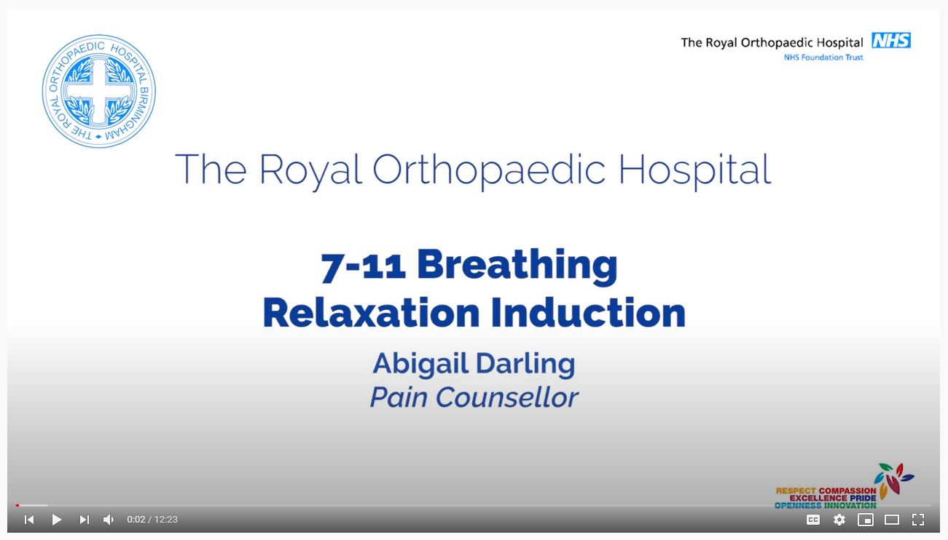
Time to relax
https://youtu.be/lszsXjozezU
Notes:
A practical session on some simple relaxation techniques patients find helpful as part of their toolkit
The relaxation response
Triggered by:
Perception of a lack of threat
Sense of safety through social contact
Pleasant emotions
Achieving goals
Solving problems
Active relaxation exercises, i.e. 7-11 breathing
Take in a deep breath (for the count of 7)
Hold briefly
Release slowly (for the count of 11)
Empty the lungs
Pause
Repeat

Slide 17
Summary of session
Notes:
Individual phone call to discuss session

Slide 18
Personal time
Notes:
Practice this when you are not in pain.
Plan:
Keep calm – panic will cloud your thinking and increase tension in your body – just what you don’t want.
Access relaxation – 7:11 breathing this will reduce tension in your body which will reduce pain and help you to think more clearly.
Accept it and anticipate recovery – flare ups of back pain are common but they needn’t ruin your life. They are part of the normal experience of back pain and with practice can be effectively managed.
Do a quick body check – is this your normal pain? Location, quality, severity. Red flags.
Check your thoughts/mood – are you catastrophising? are you angry?
Start stretching – consider your favourite stretch.
Use medication if necessary.
Consider heat/cold pack/TNS.
Modify your activity – avoid rest/over activity.
10. Reflect on what caused it (think about triggers). What can I learn?
11. Congratulate yourself on a job well done.
What are the challenges of using a flare-up plan.

Slide 19


