Slide 1


Back to Life
Session 6:
Combining Physical and Psychological Treatment for back pain

Slide 2
Review of last week
Reflections on the bathtub?
Understanding how it can link into your personal pain experience?

Slide 3
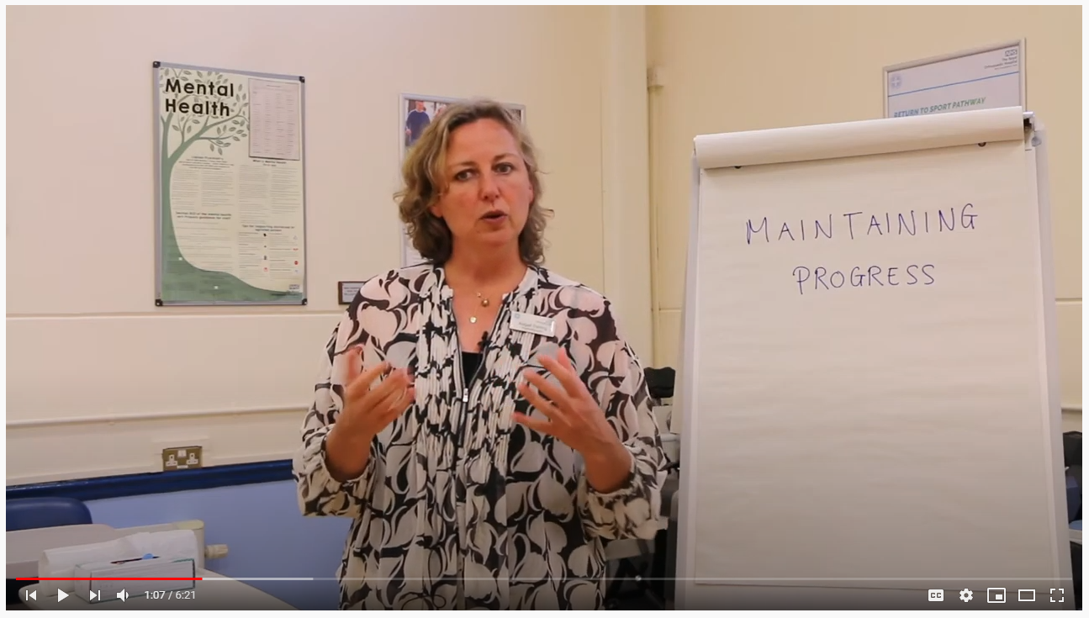
Maintaining progress
https://youtu.be/H9CstAvW04I

Slide 4
Maintaining progress in the long term
Notes:
Are we meeting our own needs?
Are we taking time to focus on our self?
Are we putting too much pressure on ourselves?
? Break out session to discuss the challenges of maintaining change

Slide 5
Motion is lotion
5 more exercises to help you recover:

Slide 6
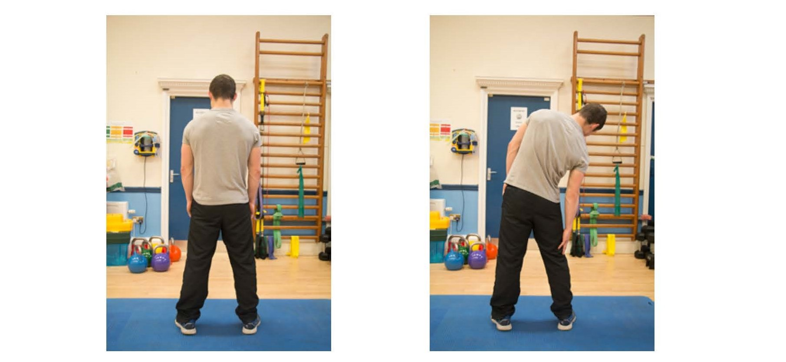
Lateral flexion
Notes:
One clinician leads this – the others observe movement patterns
Encourage patients to leave video function running – look for avoidant patterns or perfectionism
Facilitate a discussion regarding how these movements felt for patients, challenge any unhelpful beliefs

Slide 7
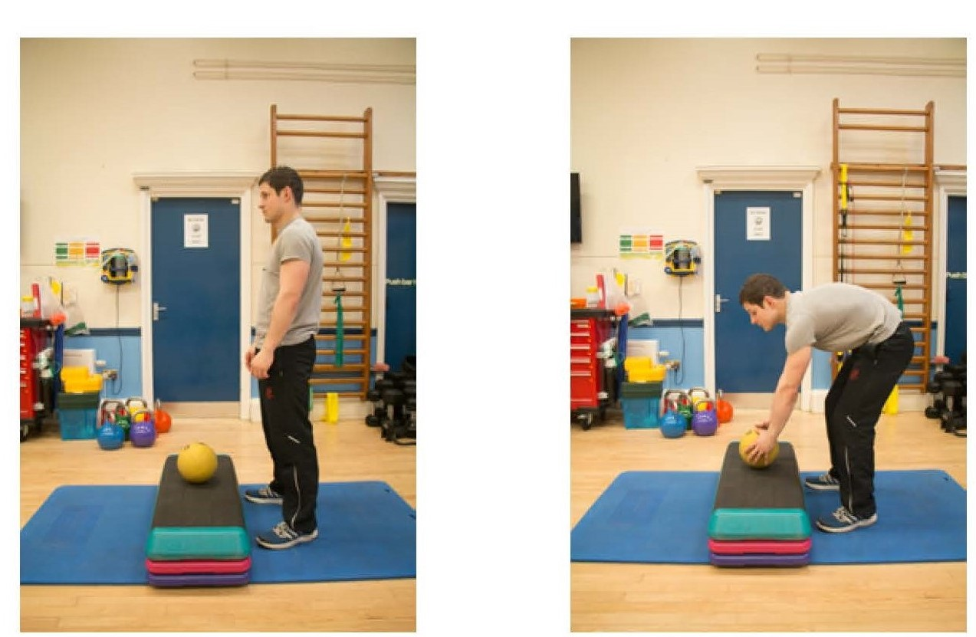
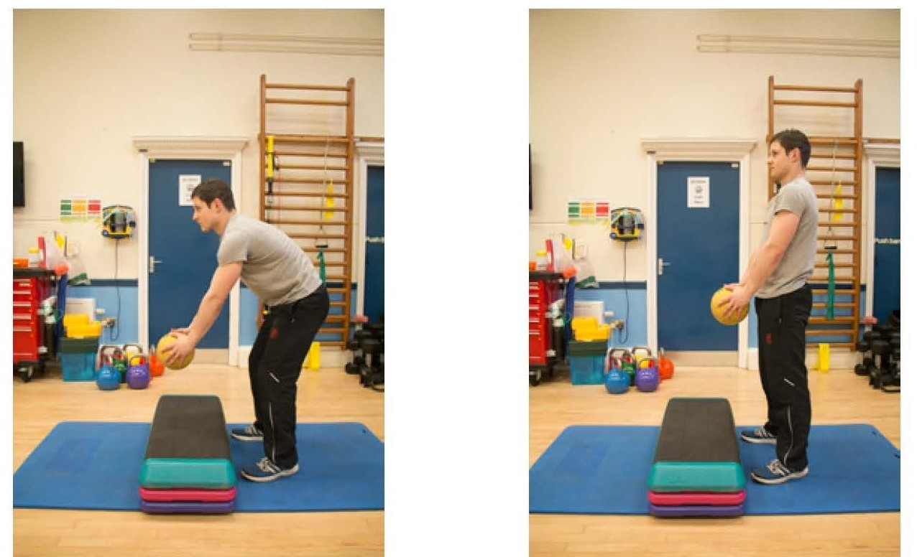
Bending and lifting
Notes:
One clinician leads this – the others observe movement patterns
Encourage patients to leave video function running – look for avoidant patterns or perfectionism
Facilitate a discussion regarding how these movements felt for patients, challenge any unhelpful beliefs

Slide 8
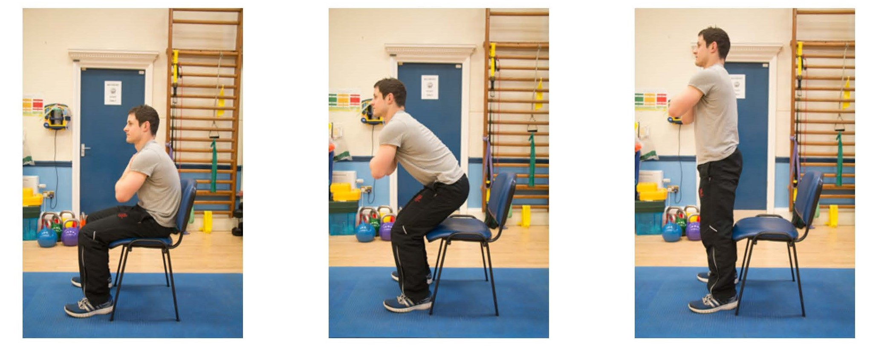
Sit to stand
Notes:
One clinician leads this – the others observe movement patterns
Encourage patients to leave video function running – look for avoidant patterns or perfectionism
Facilitate a discussion regarding how these movements felt for patients, challenge any unhelpful beliefs

Slide 9
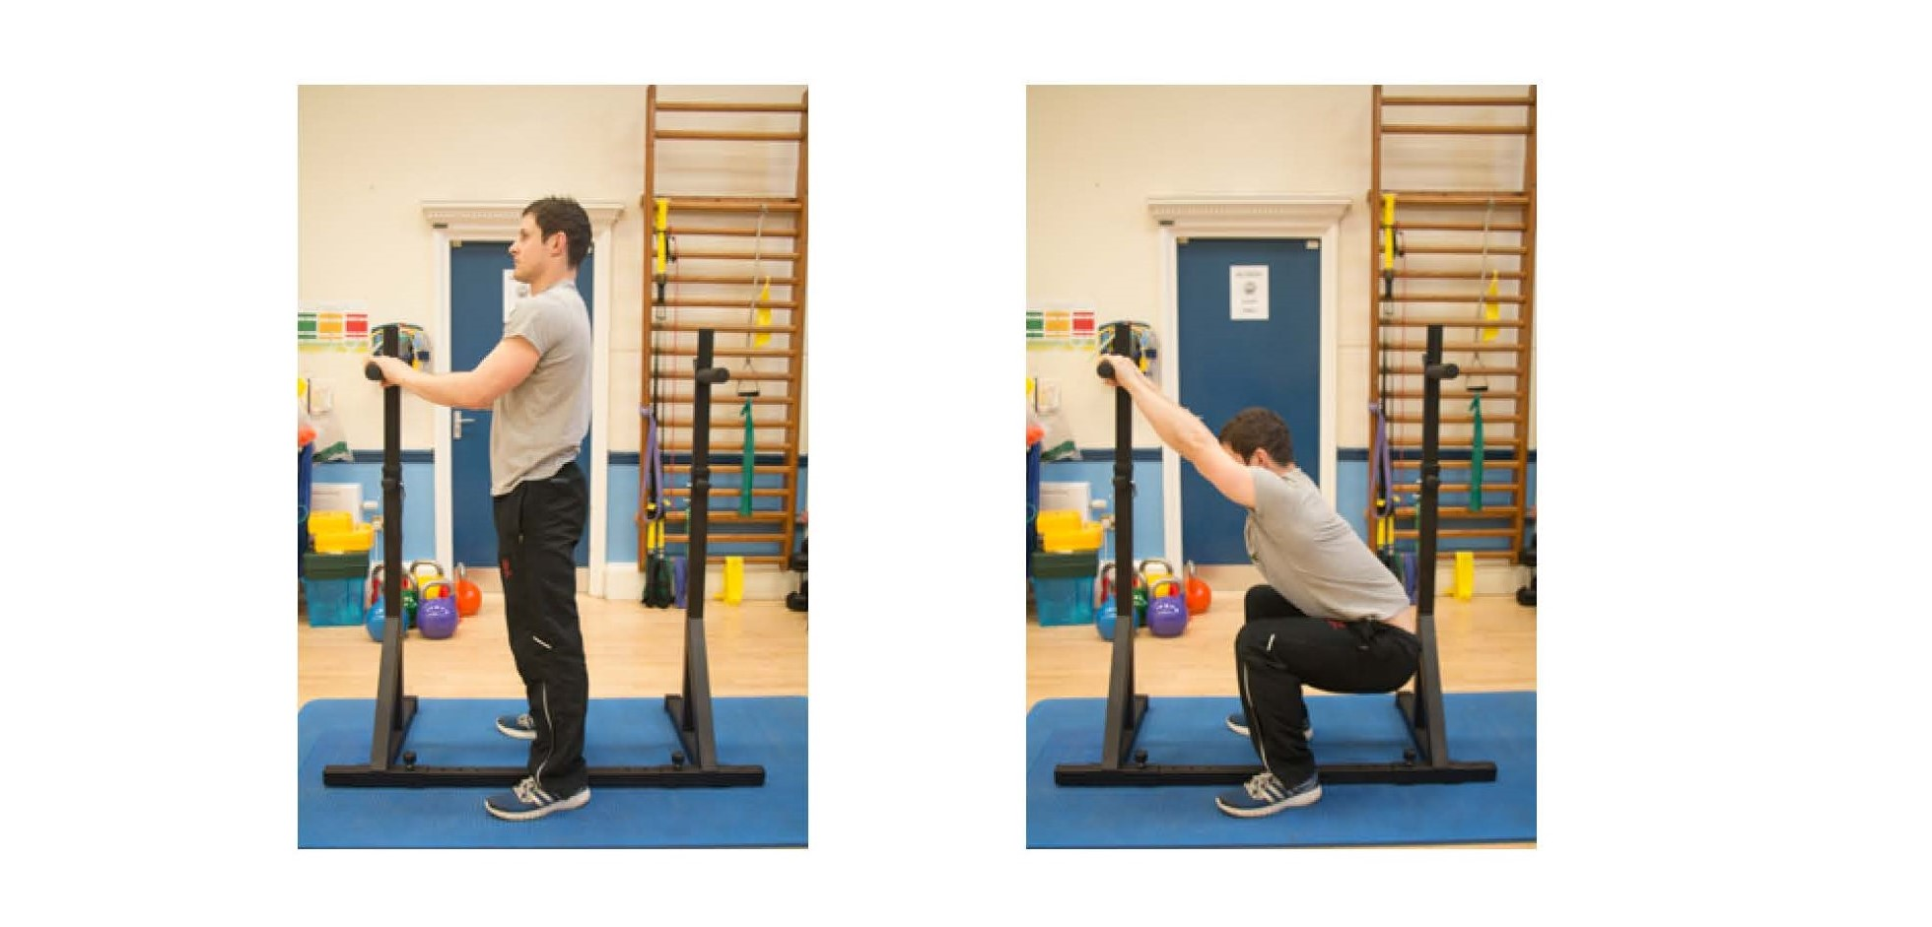
Deep squat

Slide 10
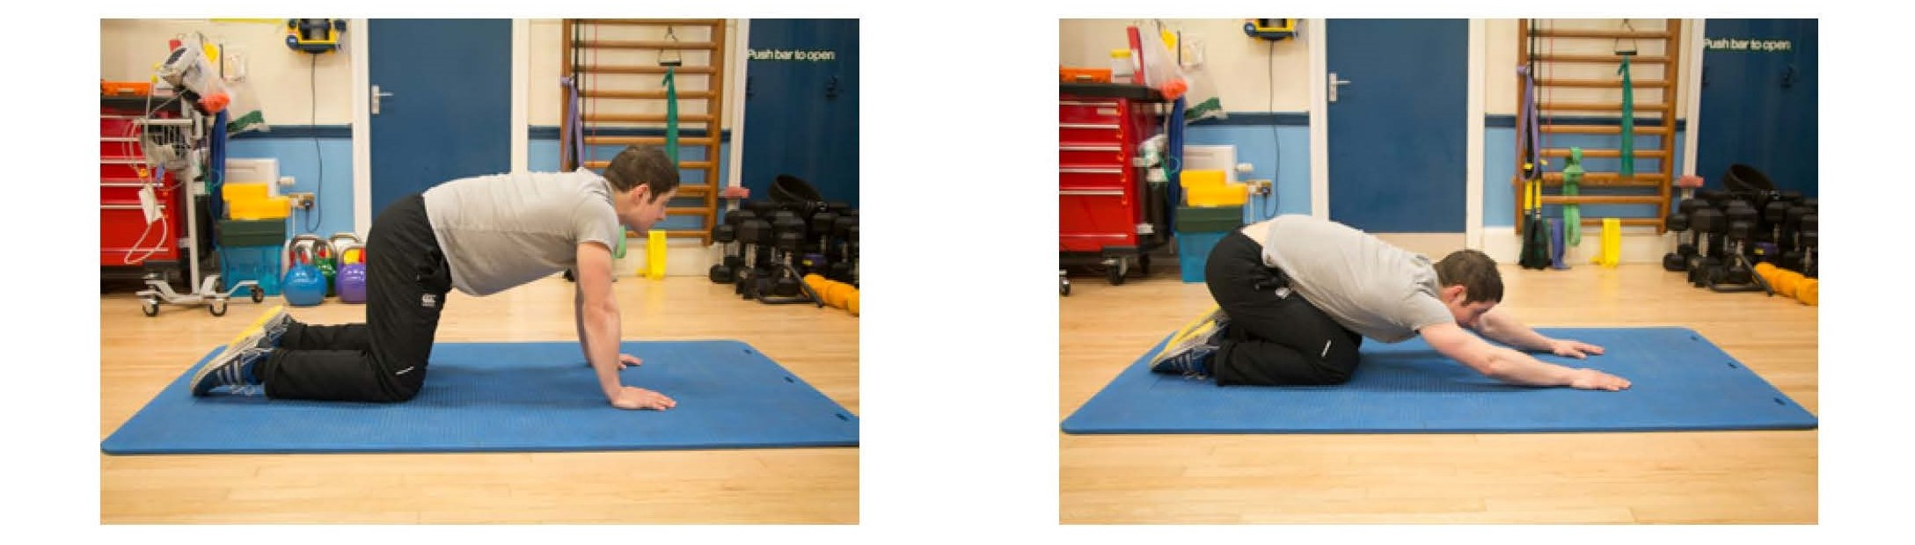
The CAT stretch
Notes:
One clinician leads this – the others observe movement patterns
Encourage patients to leave video function running – look for avoidant patterns or perfectionism
Facilitate a discussion regarding how these movements felt for patients, challenge any unhelpful beliefs

Slide 11
Using exercise to maintain progress
What plans do you have to maintain healthy exercise habits
What might prevent you being able to do this
How can you make exercise a priority

Slide 12
Guided imagery
Using visualisation to help achieve you goals

Slide 13
What happens next?
Promoting self management
Link to website resources
Completing questionnaires via email
https://www.roh.nhs.uk/our-services/msk/functional-restoration-programme/information-for-patients
Date for follow up session

Slide 14
Summary of session
Notes:
Individual phone call to discuss session

Slide 15
Personal time

Slide 16


