Slide 1


Back to Life
Session 1:
Combining Physical and Psychological Treatment for back pain

Slide 2
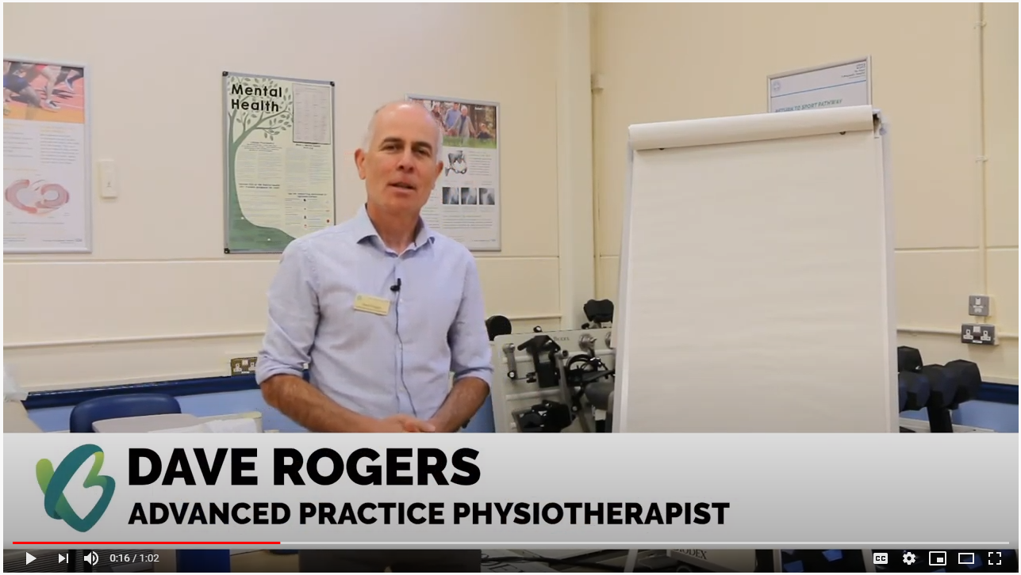
Introduction
https://youtu.be/T4fyLAqo5oo
Notes:
Set the scene, explain BPS approach explores how pain makes them feel, and how does it influence their life. Explain why group work is more effective
Team members
Back to Life – what is it, how did I get here
Ground rules
Group effect

Slide 3

Here’s what a previous participant thought of Back To Life
www.youtube.com/watch?v=YwDVzeEzb_M
Notes:
Introduce, explaining how this approach worked for this patient

Slide 4
Let’s hear your story
In pairs, find out about each other and feedback to group
Notes:
Facilitate story telling for each patient. Allow their ‘buddy’ to tell their story briefly for them
When did your pain problem start?
How does it affect you?
What do you want to change about your life from doing the course?

Slide 5
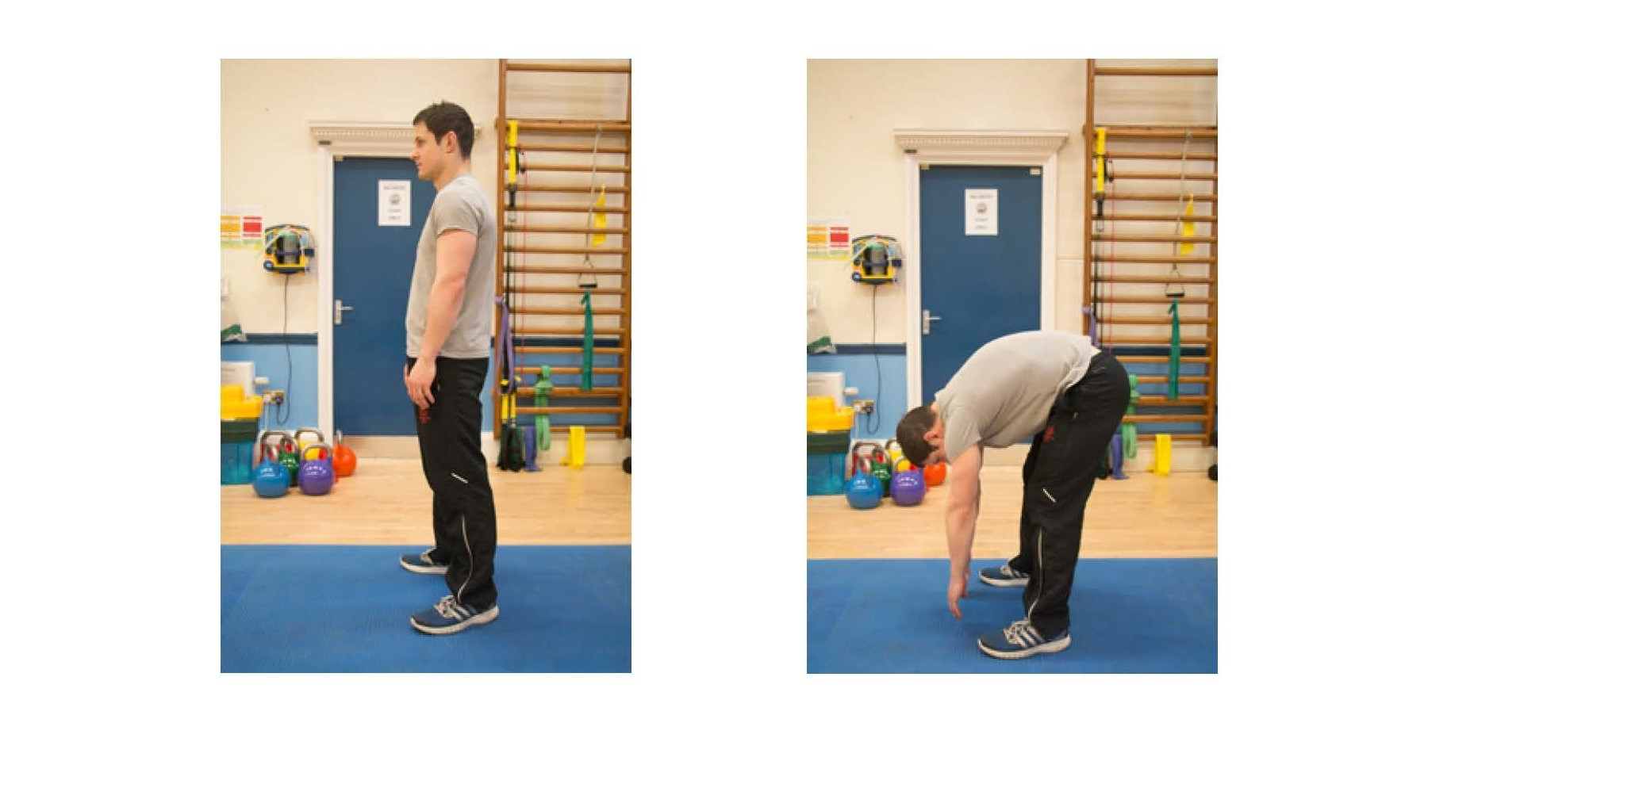
Motion is lotion
Notes:
Simple stretching and breathing exercise to introduce the value of physical activity, usually using forward bend as an example

Slide 6
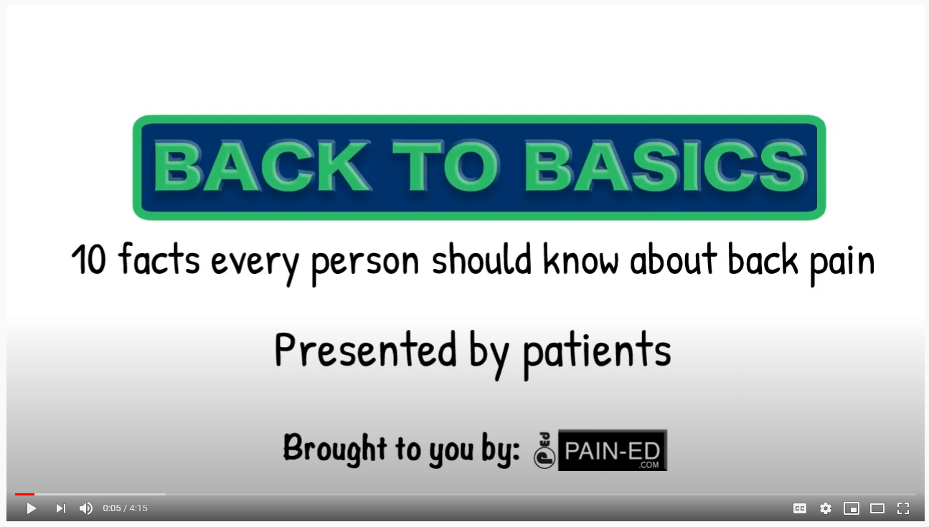
Myths and misconceptions about back pain
www.youtube.com/watch?v=Hif5Cxikdmo&feature=youtu.be
Notes:
Use video link
1. Data from worldwide studies show that 99% of back pain does not have a serious (cancer/infection/fracture) cause. Once serious disease has been excluded, the findings on scans help little in understanding the pain, its treatment or recovery and do not improve clinical outcomes. Unnecessary scanning can sometimes do harm. Most episodes of back pain recover.
2. There is no evidence that back pain gets worse over time. What we do know is that negative thoughts about back pain worries the future are strongly associated with back pain which persists.
3. Graded activity/movement in all directions is safe and good for the recovery of back pain (including flexing the spine). This may directly contradict advice you may have heard on manual handling courses or been told by HCP There is no particular set of exercises which have been shown to be superior for treating LBP. ‘Core’ exercises have a small beneficial effect on back pain but no more than any other form of exercise. Bracing the trunk muscles before activity is not recommended and can slow recovery. Graded bending and lifting should not be avoided in patients with back pain. Avoiding movements or activities which make back pain worse can promote fear and delay recovery as can maladaptive coping (alcohol, over-medication, drugs).
4. Spine posture in sitting, standing and lifting does not predict LBP.
5. Flare ups of pain are common. They are strongly associated with changes in activity levels and fluctuations in stress/mood rather than damage.
References:
Back to basics: 10 facts every person should know about back pain. Peter B O'Sullivan, J P Caneiro, Kieran O'Sullivan, Ivan Lin, Samantha Bunzli, Kevin Wernli, Mary O'Keeffe British Journal of Sports Medicine 2019 December 31 – Editorial.
https://www.hse.gov.uk/msd/backpain/index.htm
https://www.nhs.uk/live-well/healthy-body/back-pain-at-work
Saraceni, Nic, et al. "To flex or not to flex? Is there a relationship between lumbar spine flexion during lifting and low back pain? A systematic review with meta-analysis." journal of orthopaedic & sports physical therapy 50.3 (2020): 121-130.
Nolan, David, et al. "What do physiotherapists and manual handling advisors consider the safest lifting posture, and do back beliefs influence their choice?." Musculoskeletal Science and Practice 33 (2018): 35-40.
Nolan, David, et al. "How do manual handling advisors and physiotherapists construct their back beliefs, and do safe lifting posture beliefs influence them?." Musculoskeletal Science and Practice 39 (2019): 101-106.
Slater, Diane, et al. "“Sit Up Straight”: Time to Re-evaluate." journal of orthopaedic & sports physical therapy 49.8 (2019): 562-564.
NB. Education (pt centred) with positive messaging, optimising physical and mental health, sleep hygiene, meaningful and enjoyable social activity and work..

Slide 7
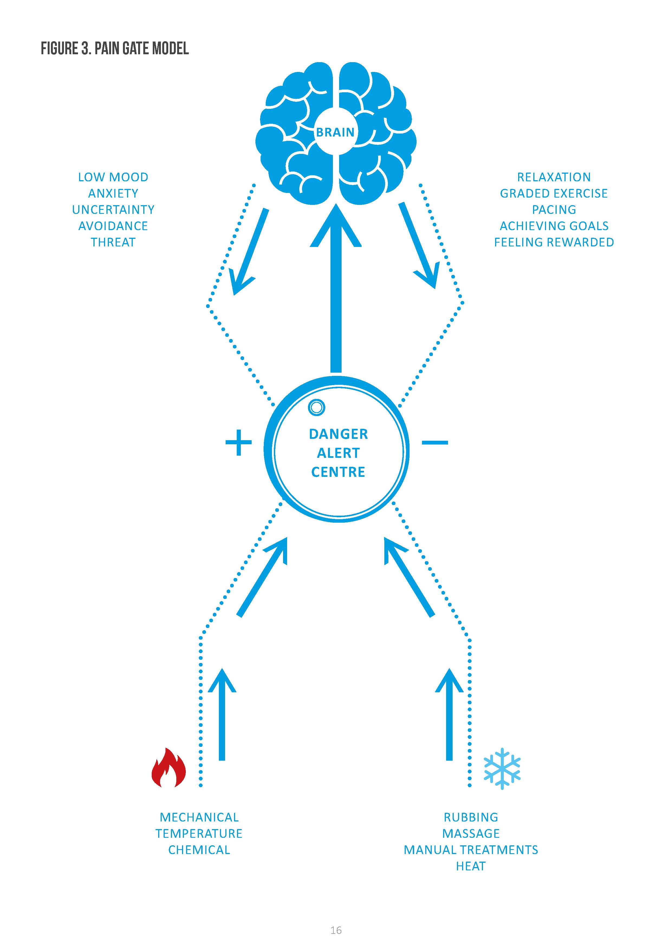
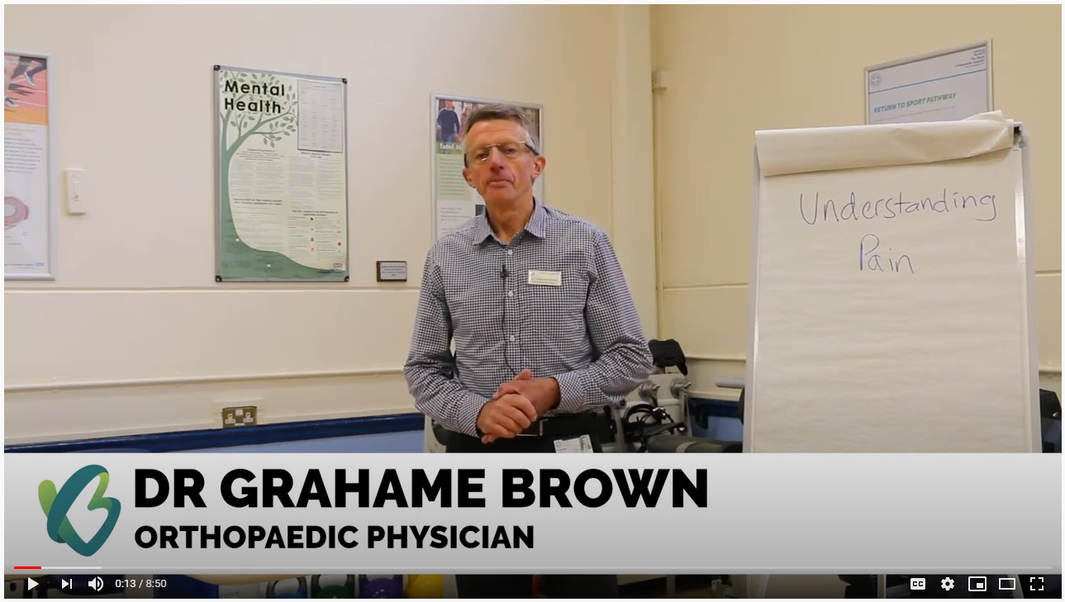
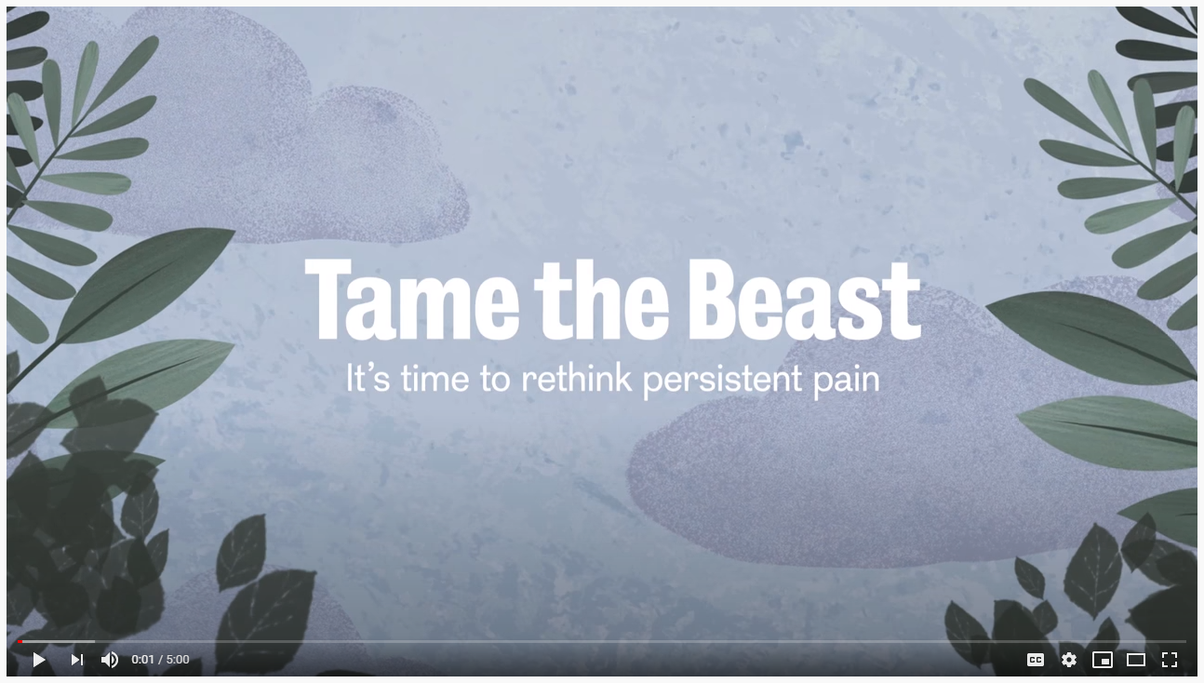
Understanding pain
https://youtu.be/LkxM4VWvqHU
https://youtu.be/ikUzvSph7Z4
Notes:
Educate patients on pain biology – keep it simple but give patients expectation of recovery.
Rewiring, patterns of movement, muscle tension, cramping, sensitivity
Allow further questions from patients regarding this approach

Slide 8
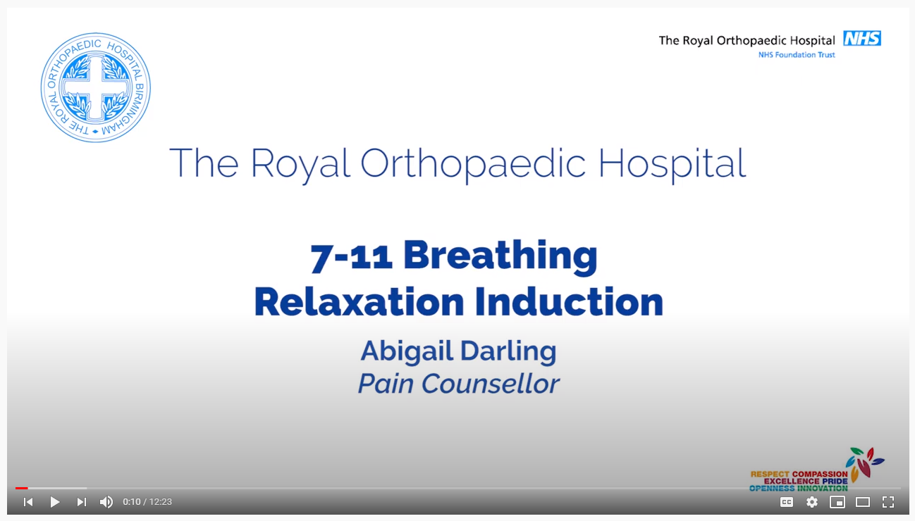
Time to relax
https://youtu.be/lszsXjozezU
Notes:
A practical session on some simple relaxation techniques patients find helpful as part of their toolkit
The relaxation response
Triggered by:
Perception of a lack of threat
Sense of safety through social contact
Pleasant emotions
Achieving goals
Solving problems
Active relaxation exercises, i.e. 7-11 breathing
Take in a deep breath (for the count of 7)
Hold briefly
Release slowly (for the count of 11)
Empty the lungs
Pause
Repeat

Slide 9
Summary of session
Notes:
Individual phone call to discuss session

Slide 10
Personal time
Notes:
Individual phone call to discuss session

Slide 11


